Slide 1
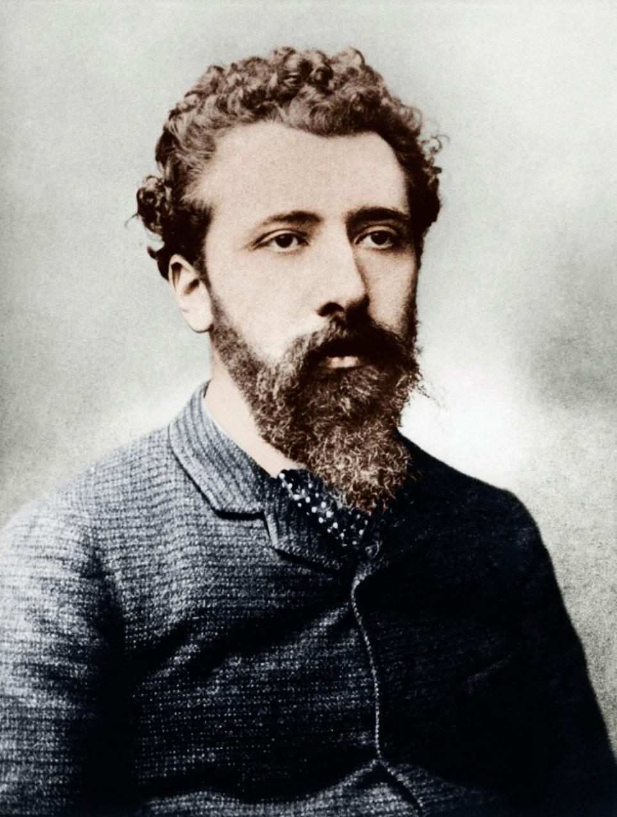
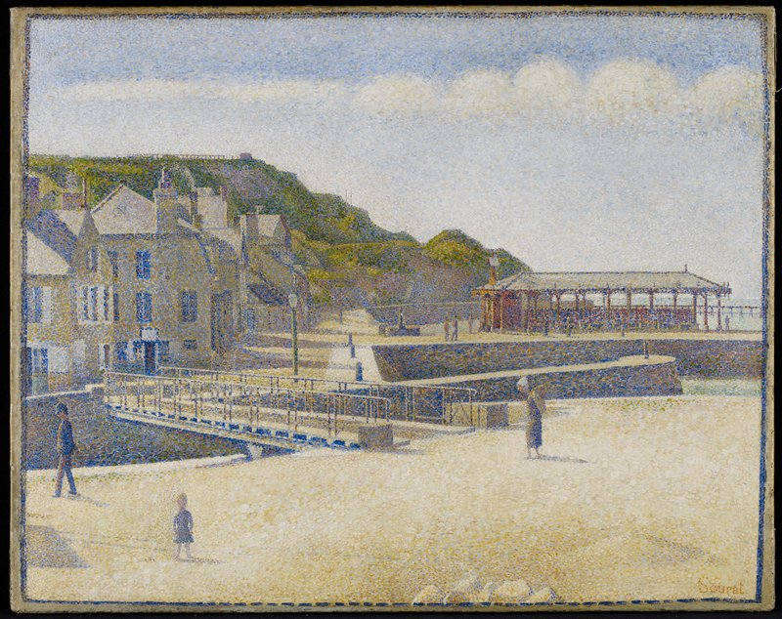
Key Vocabulary
pointillism | use tiny dots of colour close together to create an image.
tint | a colour mixed with white (to make it lighter)
shade | a colour mixed with black (to make it darker)
line | marks made by a tool
colour | the colours we see in our art
shape | a shape is the flat area surrounded by a line
texture | how something feels or looks like it feels.
Art – Painting
Knowledge Organiser
Key Knowledge
1 | George Seurat invented the art technique pointillism.
2 | Pointillism uses dots placed very close together so the human eye blends them to create an image.
3 | The three primary colours are red, blue and yellow.
4 | You add white to a colour to make a tint.
5 | You add black to a colour to make a shade.
6 | Using a range of tools creates different effects.
7 | You can create textured paint by adding sand or plaster.
Georges Seurat
He lived in France
He liked to paint people, places and nature
He used lots of tiny dots of colour in his paintings.
Prior Knowledge
1 | F1 – Lent 1 | Materials can be used with paint to create marks.
2 | F1 – Lent 2 | A thin brush creates a thin line and a thicker brush, a thick line.
3 | F1 – Pentecost 2 | Mixing paint will change the colour.
4 | F2 – Advent 1 | Mixing two primary colours creates a secondary colour.
5 | F2 – Advent 1 | Adding white and black creates different shades of colour (lighter and darker).
Port-en-Bessin

