Slide 1
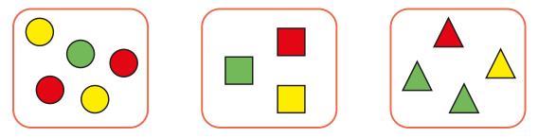
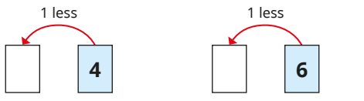
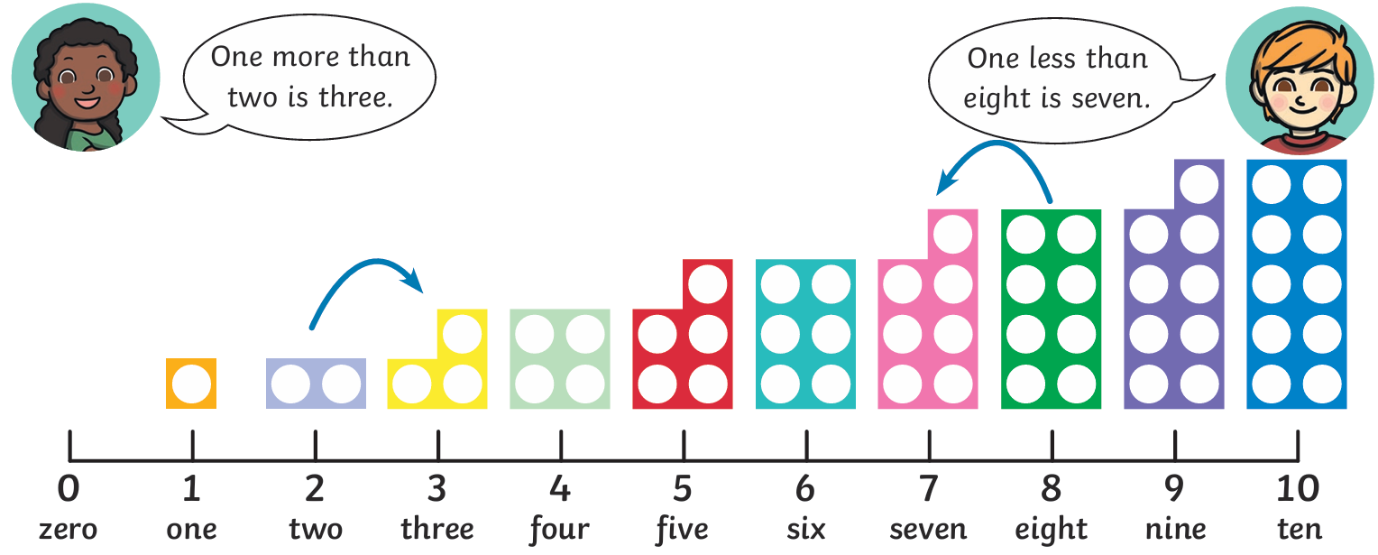
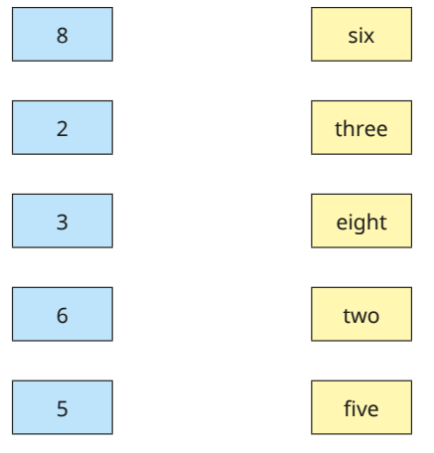
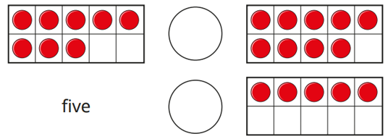
Number and Place Value: Numbers within 10 - Knowledge Organiser
Key Vocabulary
1 | one
2 | two
3 | three
4 | four
5 | five
6 | six
7 | seven
8 | eight
9 | nine
10 | ten
more | a bigger amount
less | a smaller amount
sort | group similar things together
Key Information
1 | Numbers can be compared by the amount: 10 is more than 6 2 is less than 7
2 | Objects can be sorted into different groups: shape colour size
Worked Examples
The pictures have been sorted by shape. How else could they be sorted? The pictures could be sorted by colour. The pictures could be sorted by number of sides or corners. Find 1 less than each number: Write <, > or = in each circle to compare:
Prior Knowledge
 | Number and Place Value: 1- 10 | Numbers 1 to 10 in digits
Worked Examples
Complete diagram to match the words to the numbers.
3
5

