Slide 1
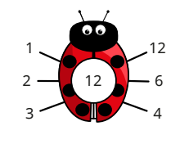
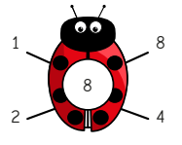
Multiplication and Division: Factors
Key Vocabulary
Factor | A number that can be multiplied by another number to give a product.
Factor pair | Two numbers that are multiplied together to give a product.
Multiple | A number that can be divided by another number, leaving no remainders.
Product | The answer to a multiplication.
Key Information
1 | To find all factors of a given number, work systematically, starting at 1.
2 | Once you begin to repeat yourself, you have found all of the factors.
Worked Examples
Working systematically to find all factors of 24: 1 x 24 2 x 12 3 x 8 4 x 6 5 x ___ → This does not work so 5 is not a factor of 24. 6 x 4 → I have already done this, so I’ll stop here.
Using factor pairs to work out 7 x 8: “I can use a factor pair of 8 to help me.” 7 x 8 = 7 x 4 x 2 7 x 4 = 28 28 x 2 = 56 Therefore, 7 x 8 = 56
Worked Examples
The factors of 12:
Prior Knowledge
Year 3 | Number: Multiplication and Division | 2, 5, 10, 3, 4 and 8 times tables.
Year 4 | Number: Multiplication and Division | 3, 6, 9, 7, 11 and 12 times tables.

Slide 2
Multiplication and Division: Multiplying and Dividing by 10 and 100.
Key Vocabulary
Digit | Each individual number within a whole number.
Multiple | A number that can be divided by another number, leaving no remainders.
Place value chart | A chart that shows a number in its ones, tens, hundreds and thousands.
Place holder | A 0 used to hold a place in a number.
Product | The answer to a multiplication.
Key Information
1 | To multiply by 10, all digits move one space to the left. A 0 is placed in the empty column.
2 | To multiply by 100, all digits move two spaces to the left. A 0 is placed in each empty column.
3 | To divide by 10, all digits move one space to the right.
4 | To divide by 100, all digits move two spaces to the right.
Worked Examples
65 x 100
7600 ÷ 10
1200 ÷ 100
Th | H | T | O
 |  | 6 | 5
Th | H | T | O
6 | 5 | 0 | 0
Th | H | T | O
7 | 6 | 0 | 0
Th | H | T | O
 | 7 | 6 | 0
Worked Examples
34 x 10
Prior Knowledge
Year 2 | Number: Multiplication and Division | 10 times tables and dividing by 10.
Year 3 | Number: Multiplication and Division | Multiples of 10 and the link between multiplying and dividing.
Th | H | T | O
 |  | 3 | 4
Th | H | T | O
1 | 2 | 0 | 0
Th | H | T | O
 | 3 | 4 | 0
Th | H | T | O
 |  | 1 | 2

Slide 3
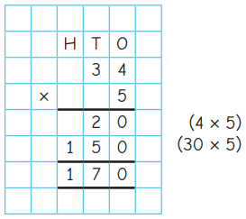
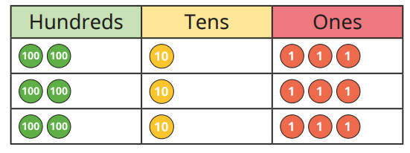
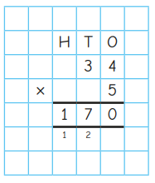
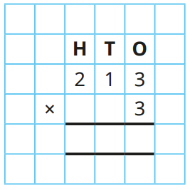
Multiplication and Division: Formal Column Method for Multiplication
Key Vocabulary
Column method | An efficient method for multiplication.
Exchange | 10 ones for 1 ten. 10 tens for 1 hundred. 10 hundreds for 1 thousand.
Expanded method | The column method, showing each multiplication calculation.
Short method | The column method, not showing every calculation.
Key Information
1 | Multiply the ones first. Then, the tens. Then, the hundreds.
2 | In the expanded method, show each calculation in brackets.
3 | In the short method, do not show calculations in brackets.
Worked Examples
Expanded method: 34 x 5
Short method: 34 x 5
Worked Examples
Using place value counters: 213 x 3
Prior Knowledge
Year 3 | Number: Multiplication and Division | Using repeated addition to multiply.
Year 4 | Number: Multiplication and Division | Times tables up to 12 x 12.
6
3
9

Slide 4
Multiplication and Division: Formal Method for Division
Key Vocabulary
Bus stop method | A formal, efficient method to divide.
Exchange | 10 ones for 1 ten. 10 tens for 1 hundred. 10 hundreds for 1 thousand.
Sharing | A method of division.
Key Information
1 | Write the number you are dividing inside the bus stop.
2 | Write the number that you are dividing by outside of the bus stop.
3 | Divide the first digit and write the answer above the bus stop.
4 | Continue dividing each digit. If there are any leftovers, exchange them into the column on the right before you divide the next digit.
Worked Examples
Bus Stop Method with Exchanges. 564 ÷ 4 = 141 4 5 6 4 1 4 1 4 5 6 4
Bus Stop Method with Remainders. 847 ÷ 6 = 141 r1 6 8 4 7 1 4 1 r1 6 8 4 7
Prior Knowledge
Year 2 | Multiplication and Division | Making equal groups.
Year 3 | Multiplication and Division | Grouping and sharing for division.
Year 4 | Number: Multiplication and Division | Times tables up to 12 x 12.
Year 4 | Number: Multiplication and Division | Multiplying and dividing by 10 and 100.
Worked Examples
Bus Stop Method with No Remainders. 399 ÷ 3 = 133 3 3 9 9 1 3 3 3 3 9 9
1
2

Slide 5
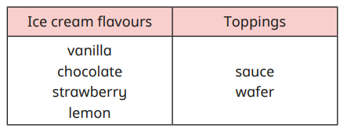
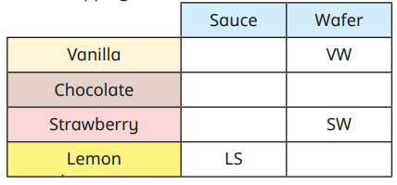
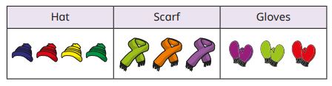
Multiplication and Division: Correspondence Problems
Key Vocabulary
Combination | A joining of different parts.
Correspondence problem | When a part of one problem links to a part of another problem.
Systematic | Working in a logical order – an order that makes sense – so that you do not miss any possibilities.
Key Information
1 | Create a code for each item in the table.
2 | Choose one item and find every combination that could go with it.
3 | Choose the second item and find every combination that could go with it.
4 | Continue until you have found all possible combinations.
5 | Use your times tables to check if you have found the total amount of combination. Multiply one column by the other(s).
Worked Examples
4 flavours – 2 toppings 4 x 2 = 8 There are 8 combinations.
Prior Knowledge
Year 3 | Multiplication and Division | How many ways?
Year 4 | Number: Multiplication and Division | Times tables up to 12 x 12.
Worked Examples
5 hats - 3 scarves - 3 pairs of gloves 5 x 3 x 3 = 45 There are 45 combinations.
VS
CS
CW
SS
LW

