Slide 1
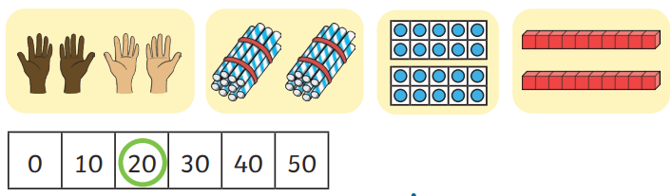
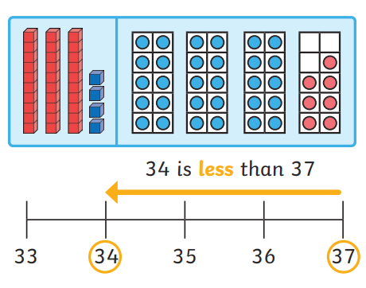
Number: Place Value within 50 Knowledge Organiser
Worked Examples
20 is 2 lots of ten 20 is 2 groups of ten 34 is less than 37
Key Information
1 | Numbers within 50 can be counted using different resources. For example, number lines, half 100 squares and using tens and ones.
2 | Numbers can be counted in groups of 10.
3 | Objects can be made into groups of ten to be counted.
4 | Tens and ones can be used to make numbers to 50.
5 | Whole numbers can be partitioned into tens and ones
Key Vocabulary
smallest | A number smaller than another number.
greatest | A number bigger than another number.
compare | Talk about what is similar and what is different about numbers.
tens | A group of ten ones.
ones | A digit from 1 to 9.
order | Arranged or organised in a given way
estimate | To carefully choose an answer based on what you already know.
Prior Knowledge
EYFS | Number | Recognise numbers to 10 and some to 20.

