Slide 1
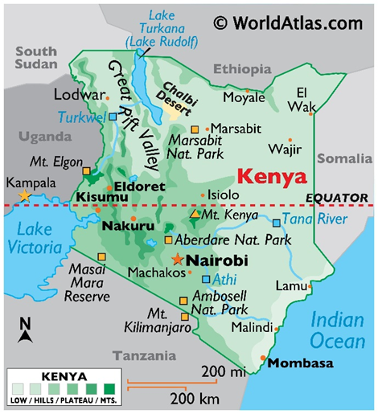
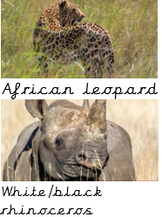
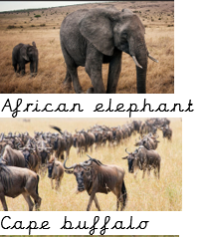
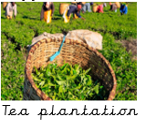
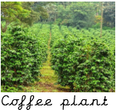
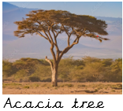
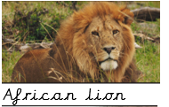
Knowledge Organiser – Geography Safari Street Detectives
Key Vocabulary
Savanna (Also known as grasslands) | Prairie or plains covered with tall grasses. They may have scattered bushes and trees. They have seasonal rains and dry periods.
population | Is the number of people living on a certain place
wildlife | Animals and plants living naturally in the environment.
continent | A large area of land.
country | A home to a specific group of people controlled by a government.
developing country | A country where people live with less.
Key Information
1 | Kenya is a country in the continent of Africa.
2 | England in the UK and Kenya in Africa and can be found on a world map
3 | Nottingham is a city in England and Nairobi is a city in Kenya.
4 | Some human and physical features are the same in Kenya and England and some are different.
5 | Large animals such as buffalos, lions, leopards and rhinos live wild in Kenya which are different to the wildlife in England.
6 | Kenya is still developing and half live in poverty. Different countries develop in different ways
7 | Tea and coffee are plants grown in Kenya because of the climate.
8 | Land usage supports the habitats of the wildlife in Kenya.
Prior Knowledge
Y1 | Disciplinary Knowledge | Mapwork. To locate countries on maps
Y1 | Bright lights, Big City | Know they live in Nottingham, and it is a city in the centre of England, a region called the Midlands.
Y2 | Poles Apart | Identify the areas studied in relation to the equator and make predications about climate
Y2 | Poles Apart | Know that the climate in Kenya is very hot as the equator runs through it

