Slide 1
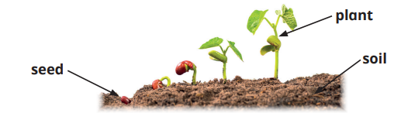
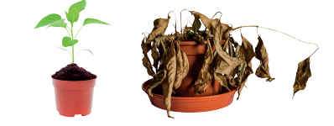
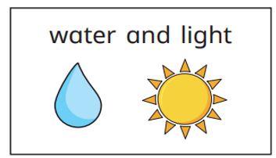
Knowledge Organiser Science Plants
Key Vocabulary
Plant | A living thing that usually grows in soil
vegetable | Part of a plant that can be eaten as food
herb | A plant used to flavour food
seed | Part of a plant that can grow into a new plant
Sun light | Light from the sun
Blossom | Flowering part of tree
Leaf | Flat green part of a plant
stem | Long thin part of a plant
Trunk | Main stem of a tree
branch | Part of a tree that grows from the trunk
Independent Variable | what will change)
Dependent Variable | what will be measured)
Controlled variable | what is kept thsame
Key Information
1 | A plant is a living thing. There are many different types of plants. Many plants have flowers or fruit. Parts of some plants can be eaten
2 | Trees have roots, a trunk, branches and leaves. Many trees have blossom or fruit. Flowering plants have roots, a stem, leaves and petals
3 | Plants need water to grow and stay healthy. Plants need light to grow and stay healthy. If plants do not have water and light, they may become weak and not grow properly.
4 | Investigations can be planned and carried out to find out if plants grow better in the dark or light
Prior Knowledge
Y1 | Plants | Plants have many parts. • Each plant part has a name. • Flowering plants have flowers, stems, roots and leaves
 |  | • Trees are a type of plant. • Trees can be different shapes and sizes. • Trees have roots, a trunk, branches and leaves. • Some trees have fruit.
 |  | • Wildflowers have not been chosen by humans to grow in their garden. • Most wildflowers have not been planted by humans. • Garden plants have been chosen by humans to grow in their gardens.
 |  | • Wildflowers have not been chosen by humans to grow in their garden. • Most wildflowers have not been planted by humans. • Garden plants have been chosen by humans to grow in their gardens.

