Slide 1
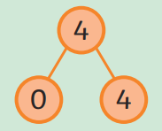

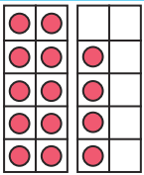
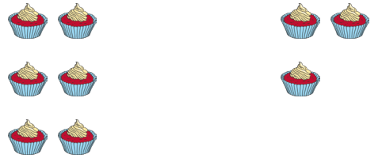
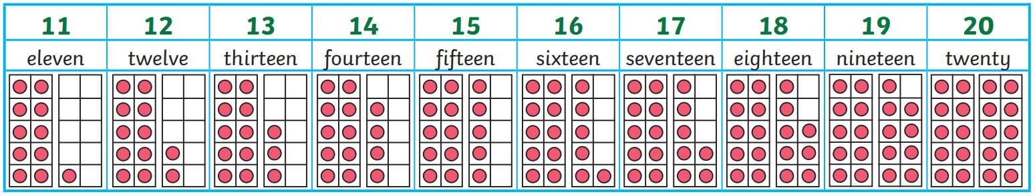
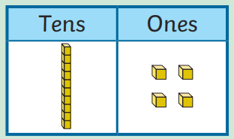
Number and Place Value: Numbers within 20 - Knowledge Organiser
Key Vocabulary
11 | eleven
12 | twelve
13 | thirteen
14 | fourteen
15 | fifteen
16 | sixteen
17 | seventeen
18 | eighteen
19 | nineteen
20 | twenty
< | less than
> | greater than
= | equal to
Worked Examples
Match the representations Can you name each of these representations?
Key Information
1 | Numbers between 10 and 20 consist of a ten and ones.
2 | Using a double tens frame, bead strings and base 10 equipment can help us represent the full ten and the additional ones
3 | Part whole models can be used to show numbers partitioned into ten and ones
4 | Inequality symbols can be used to compare numbers
14 | 4
Worked Examples
Insert the correct symbol to compare the amounts
Prior Knowledge
FS | Number and Place Value: 1- 10 | Numbers 1 to 10 in digits
Y1 Advent 1 | Place Value within 10 | Recognising numerals 1-10 1 more or less < and > symbols
>

