Slide 1
Long term impact of speech and language
The important role of spoken language – key facts
Spoken language is the foundation life skill, underpinning the ability to
learn, make friends and manage behaviour. The evidence to support this
is strong.
Language underpins good literacy development. Successful development
of literacy depends on good spoken language skills. If children struggle with
spoken language at an early age it puts them at risk for literacy difficulties
later on. The evidence shows that

Slide 2
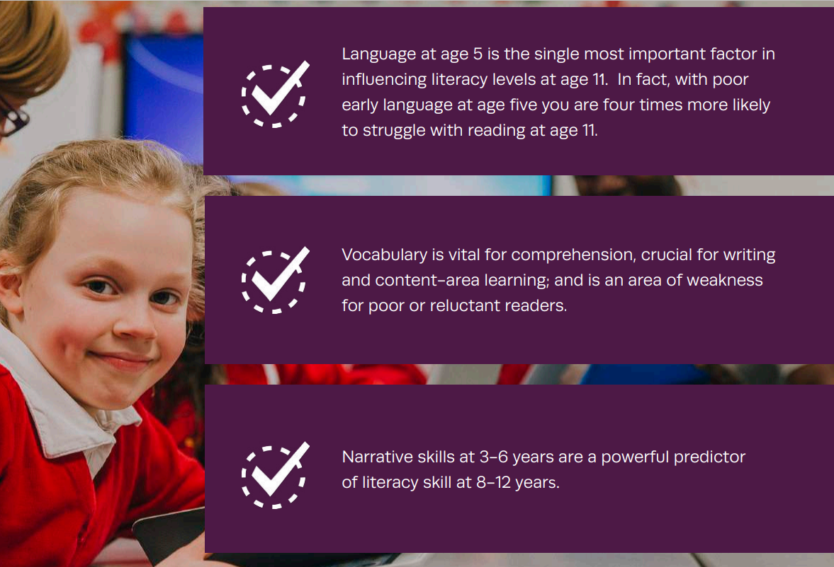

Slide 3
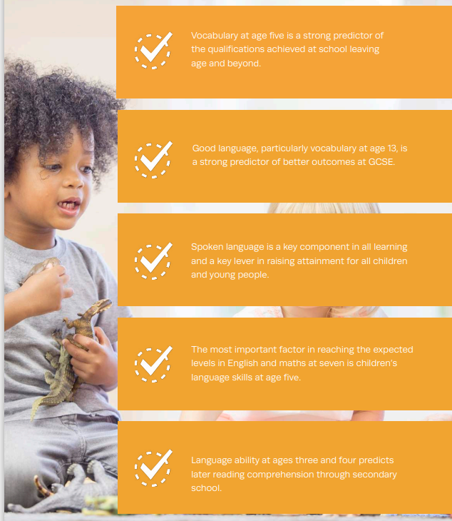
Learning and attainment
Every aspect of learning relies on good spoken language skills. Spoken
language skills have a significant impact on academic achievement.
The evidence shows

Slide 4
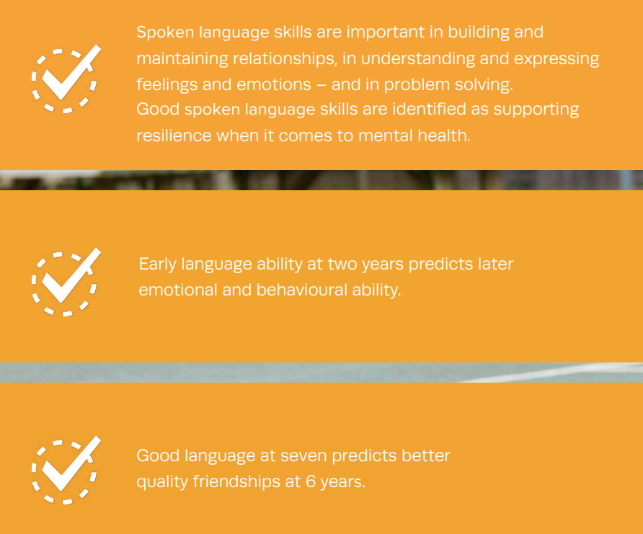
Social and emotional development
Spoken language is crucial for social and emotional wellbeing, and
for developing relationships. Children and young people with poor
language skills can struggle with these aspects of life. Evidence
shows:

Slide 5
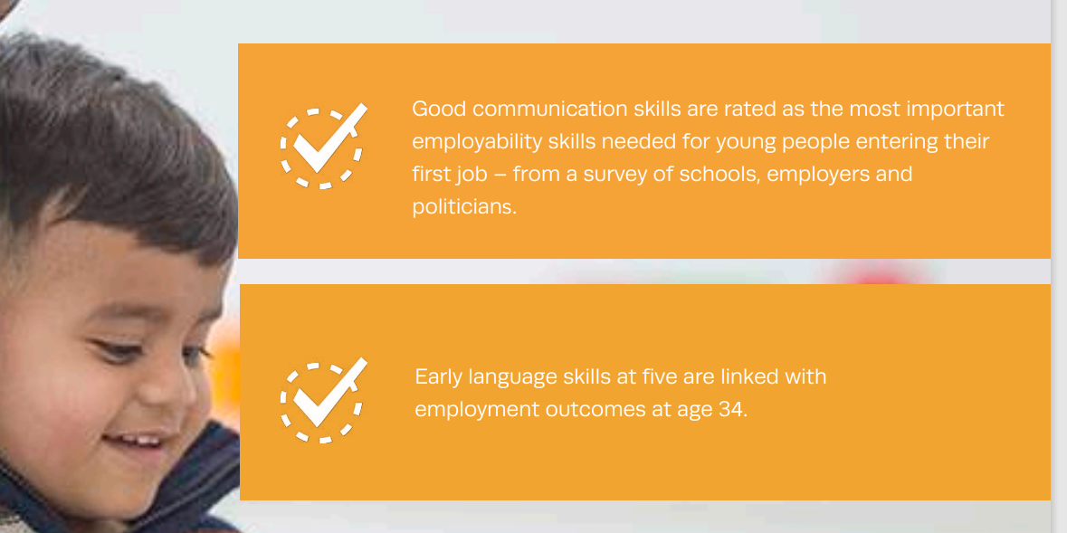
Employment
There are links between good spoken language and later employment outcomes:

