Slide 1
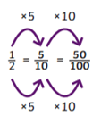
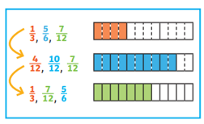
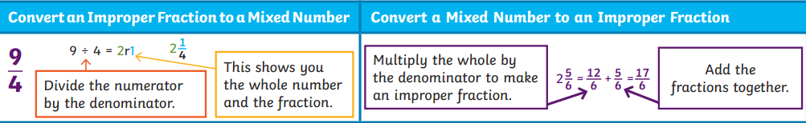
Fractions: Equivalent Fractions, Comparing Fractions, Improper Fractions and Mixed Numbers.
Key Vocabulary
Numerator | The top number of a fraction.
Denominator | The bottom number of a fraction.
Fraction | A fraction is a part of a whole.
Whole | A positive number that does not contain a fraction or decimal.
Improper fraction | A fraction where the numerator is greater than the denominator.
Mixed number | A number that includes a whole number and a fraction.
Unit fraction | A fraction where the numerator is 1.
Non-unit fraction | A fraction where the numerator is not 1.
Key Information
1 | Unit fractions can be expressed in other forms.
2 | When looking for equivalent fractions, use knowledge of factors and multiples to find common denominators.
3 | Improper fractions can be converted into mixed numbers, which consist of a whole number and unit fraction.
4 | To find equivalent fractions, we multiply and divide the numerator and denominator by the same number.
5 | We can compare and order fractions by using common denominators.
Worked Examples
Prior Knowledge
Y4 | Fractions | Recognise and show equivalent factions.
Y3 | Fractions | Compare and order fractions with the same denominator.
Y3 | Fractions | Recognise and show equivalent fractions with small denominators.
Y2 | Fractions | Recognise the equivalence of 2/4 and 1/2 .

