Slide 1
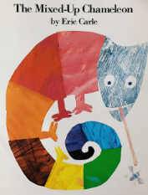
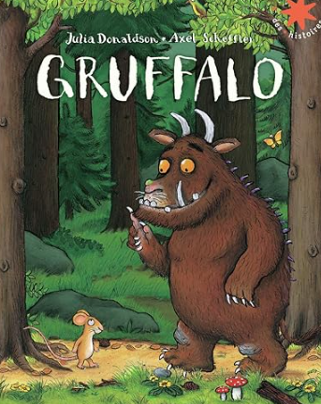
Character Description
Key Vocabulary
Character description | A type of writing that gives the reader information about a character.
Finger spaces | Finger spaces are used between words, so each word stands on its own and has its own meaning.
Sentence | A set of words that record a complete thought. It uses a subject and predicate.
Full stop | A symbol which shows the sentence has stopped.
Capital letters | Larger letters which are used to start a sentence. Some are formed differently to lower case letters.
Worked Examples
Capital letters: A giraffe has a long, flexible neck. The Gruffalo has knobbly knees and turned-out toes.
Key Information
1 | A capital letter is used to start a sentence.
2 | A sentence has a subject, predicate and a way of stopping the sentence. We use a capital letter to start the subject of the sentence.
Prior Knowledge
F2 | Pentecost 2 | Write simple phrases which can be read by others.
F1 | Pentecost 2 | Know what a sentence looks like.

