Slide 1
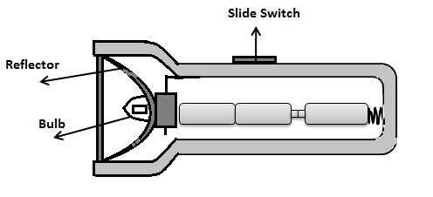
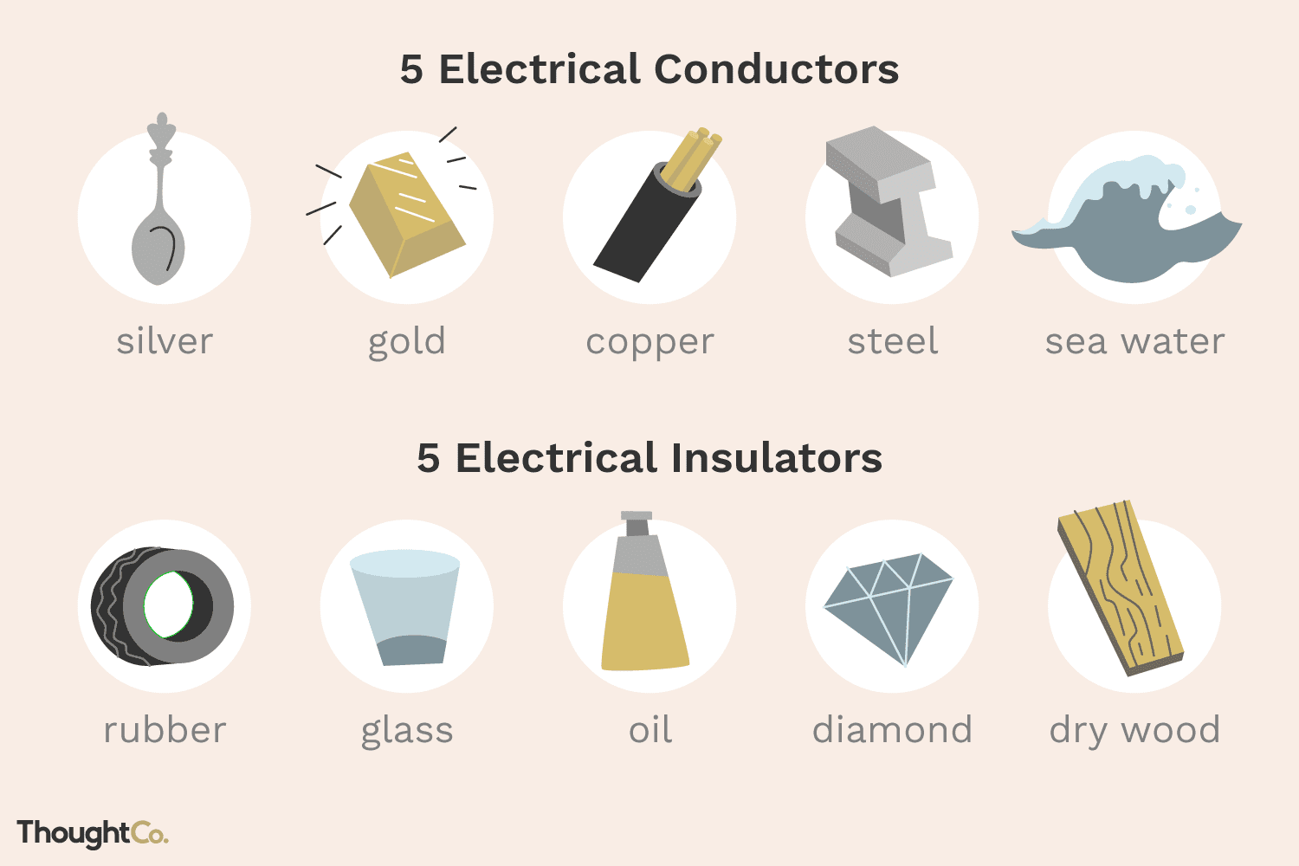
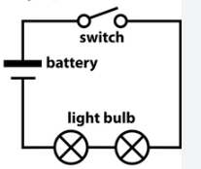
Key Vocabulary
battery | Made from two or more cells that provide electrical energy to power a circuit.
bulb | A part of a circuit made from glass or plastic that gives light when electricity passes through it.
conductor | A material that allows electricity to flow through it, such as metal.
Design criteria | A set of instructions for the project.
electricity | A type of energy that is usually invisible and can be made or stored to make things work, such as moving or heating objects.
Insulator | A material that does not let electricity flow through it such as plastic.
Series circuit | A closed circuit where the current flows in one path.
Switch | A part of a circuit that can open or close to allow electricity to flow or stop it from flowing, such as a light switch that turns lights on or off.
test | To find out whether something works as it should
torch | A battery-powered light that can be carried.
wire | A thin piece of copper that conducts electricity and connects circuit components together.
D&T – Electrical Systems
Knowledge Organiser
Key Knowledge
1 | An electrical system is a group of components that work together to transport electricity.
2 | Torches use an electrical system (a circuit) in order to create light.
3 | Torch features include casing, bulbs, switches and reflectors.
4 | Electrical conductors are materials which electricity can pass through and electrical insulators are materials which electricity cannot pass through.
5 | A battery contains stored electricity that can be used to power products.
6 | An electrical circuit must be complete for electricity to flow.
7 | A switch can be used to complete and break an electrical circuit.
Prior Knowledge
1 | Year 2 – Structures | How to make a structure strong, stiff and stable.
2 | Year 2 - Structures | Use appropriate materials and construction techniques to support, strengthen and make something secure.
3 | Year 3 – Electrical posters | An electrical system is a group of parts (components) that work to transport electricity around a circuit.
4 | Year 3 – Electrical posters | Design criteria are a set of instructions for a project.
5 | Year 3 – Electrical posters | The design cycle includes; research, design, make and evaluate.
Key People
Benjamin Franklin – Known as the lightning tamer and researched positive and negative charges. Thomas Edison – Invented a form of light bulb.

