Slide 1
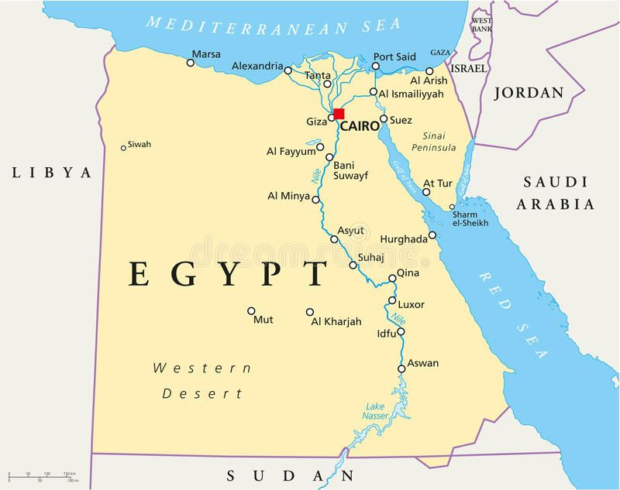
Egypt Knowledge Organiser
Key Vocabulary
Developing country | A country with a relatively low standard of living, including high levels of poverty, poor education and shorter life expectancy.
Developed country | A country with a higher standard of living, including more businesses and infrastructures, better education, higher life expectancy.
United Nations (UN) | An associated of independent countries to work together to improve conditions.
Papyrus | A plant which grows on the bank of the River Nile, it is used to make paper.
Wetland | The wetland biome experiences annual floods to provide nourishment.
Desert | The desert biome is the hottest biome. Generally, deserts get 10 inches or less of rain each year.
Temperate deciduous forest | Temperate deciduous forest has stable temperature. It has four distinct seasons.
Trade links | The buying and selling of goods and services between different settlements.
Biome | Areas of the planet with similar climate and landscape, where similar animals and plants live.
Climate | The long-term pattern of weather in a particular area.
Key Information
1 | Egypt is in the continent of Africa.
2 | Developed countries tend to be in the Northern Hemisphere.. Developing countries tend to be in the Southern Hemisphere.
3 | Developing countries may have limited access to safe drinking water. Developing countries tend to have higher levels of poverty. Developing countries have low levels of education and poor health services. Developed countries have higher life expectancies. Developed countries have lower levels of poverty.
4 | Geographers use social, economic and political indicators to measure development of countries throughout the world.
5 | The River Nile provides rich, fertile land for farmers. The River Nile empties into the Mediterranean Sea. Southern Egypt's landscape contains low mountains and desert. Northern Egypt has wide valleys near the Nile and desert to the east and west.
6 | The River Nile is Egypt’s main source of water. The River Nile provides rich, fertile land for farmers. It is used for transport and farming.
7 | The River Nile is 6,650km long, making it the longest river in the world. The River Nile runs through 9 countries. The River Nile empties into the Mediterranean Sea.
8 | The River Thames is 346km long, making it the longest river in England and the second longest in the United Kingdom The mouth of the Thames is the North Sea at the Thames Estuary
9 | Land around the River Nile was fertile. Water from the Nile was used by farmers to water crops. Nile was used for farming, transport, trade and water. Papyrus was used to make paper.
10 | Egypt has desert and wetland biomes. England has a temperate forest biome.
Prior Knowledge
1 | Y3 Flow | The Rive Nile is one of the world’s most famous rivers.
2 | Y3 Flow | Rivers flow downwards from high ground, towards the sea. This is what causes the Nile to flood annually.
3 | Y3 Ancient Greece | To understand the key aspects of settlements, linking to why people first settled near rivers.
4 | Y5 London to Rio | A biome is an area of the planet with a similar climate and landscape, where similar animals and plants live.

