Slide 1
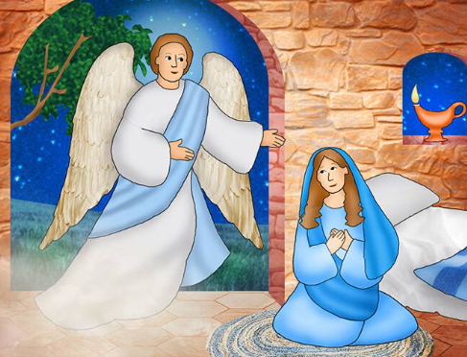
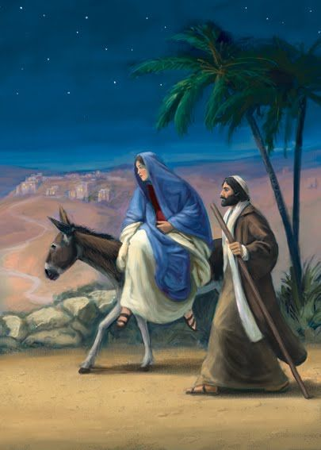
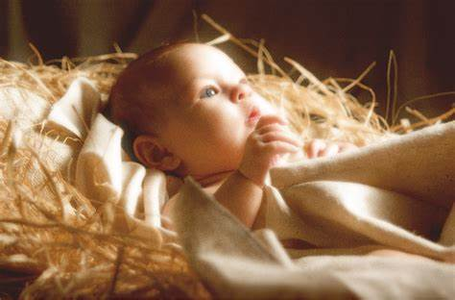
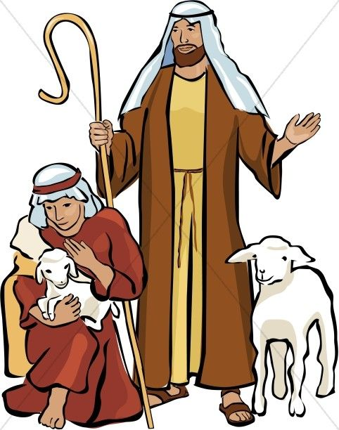
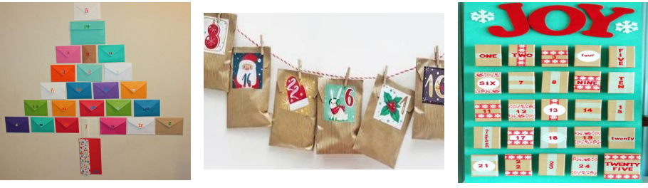
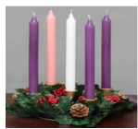
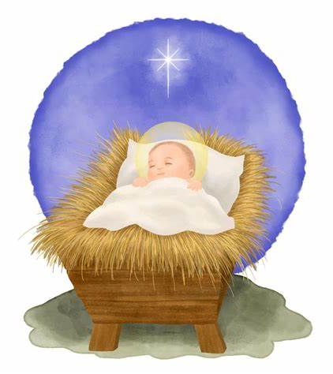
EYFS R.E. Advent 2
Prophecy and Promise
Subject Specific Vocabulary
Mary | A special lady chosen by God to be Jesus’ mother.
Jesus | God’s son who was born in Bethlehem.
Bethlehem | A place chosen by God for Jesus to be born in. it is a small town and not an especially important place; God chose it to show Jesus is for everyone.
stable | A building where livestock, mainly horses, are kept.
saviour | A person who saves someone or something from danger or difficulty. Jesus saves us from our sins.
Advent | The first season of the Church year, leading up to Christmas and including the four preceding Sundays
Sticky Knowledge
Angel Gabriel visited Mary and told her she was going to have a baby.
Mary said yes to God’s plan, even though it was scary! Mary and Joesph travelled to Bethlehem.
Mary gave birth to Jesus in a stable. Shepherds came to visit.
Advent is a time of waiting and preparing for Jesus and Christmas.
Jesus came to the world for everyone!

