Slide 1
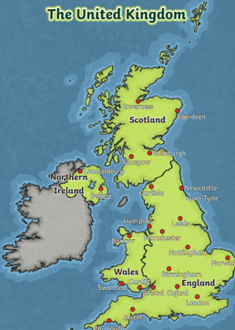
Bright Lights, Big City Knowledge Organiser
Key Vocabulary
county | A large area of land that has its own government.
capital city | A city that is home to the government and ruler of a country.
city | A large town, often with a cathedral.
village | A small group of houses and buildings that is usually in the countryside.
country- side | An area of land with fields, villages and farms.
rural | Used to describe an area that is located in the countryside.
Urban | Used to describe an area of land or human settlement where lots of people live and work.
land-mark | An important building or place.
Key Information
1 | The United Kingdom is made up of 4 countries- England, Northern Ireland, Scotland and Wales.
2 | There are 4 capital cities in the UK- London, Edinburgh, Cardiff and Belfast.
3 | Seas surround the land of the UK. The seas are- Irish Sea, North Sea and the English Channel.
4 | The River Thames is the river in the capital city London.
5 | Some land is rural and some land is urban. They have different human and physical features.
6 | There are famous landmarks in London. For example, Buckingham Palace, Big Ben and The London Eye.
7 | We use directional language to say where things are on maps. We can use compass points North, East, South and West to help us with this.
Prior Knowledge
F1 | Children know there are different places in the world and have seen photographs.
F2 | To notice objects and features in their own environment. Children know aspects of a familiar world, such as where they live.

