Slide 1
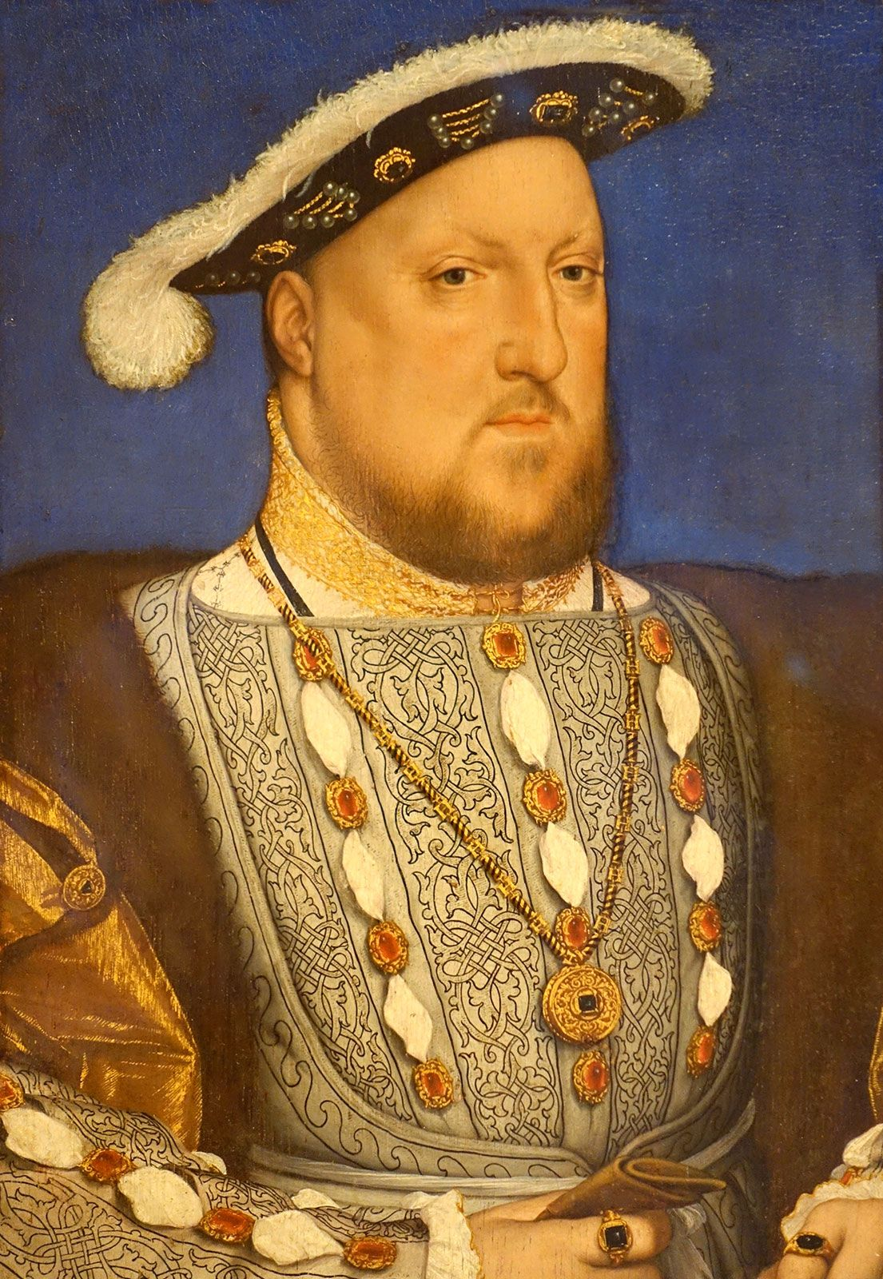
Off With Her Head Knowledge Organiser
Key Vocabulary
Annulment | A legal procedure in which something is no longer legally binding.
Christianity | A religion based on the Bible and the belief in God and Jesus Christ.
Church of England | A Protestant branch of Christianity created by Henry VIII.
divorce | A legal process to end a marriage.
English Reformation | The breaking away of the Church of England from the authority of the Pope and the Roman Catholic Church during the 16th Century.
Protestantism | The beliefs and activities of the Christian Church that separated from the Roman Catholic Church during the 16th Century.
reign | The period that a monarch rules.
Roman Catholicism | The beliefs and activities of the Roman Catholic Church, a branch of Christianity headed by the Pope.
Tower of London | A fortress in London used for many purposes, including a prison and execution ground.
treason | The crime of betraying your country and going against the ruler or government.
Key Knowledge
1 | The Tudor Period started in 1485 and ended in 1603.
2 | Henry VIII was king from 1509 to 1547. He was known for his six wives – Catherine of Aragon, Anne Boleyn, Jane Seymour, Anne of Cleves, Catherine Howard and Catherine Parr.
3 | Henry VIII’s wives had different fates – divorced, beheaded, died, divorced, beheaded, survived.
4 | Henry VIII broke away from the Catholic church when the Pope refused to grant him a divorce.
5 | Henry VIII created the Church of England, of which he was the head. Every subsequent English monarch was the head of the Church of England.
6 | Following the religious reformation, being Catholic became a crime. This led to the dissolution of monasteries, resulting in many rebellions.
7 | Following the religious reformation, the Bible was published in English, making religion more accessible. Before this, the Bible was only published in Latin.
8 | Henry VIII’s heir, Edward I was a devout Protestant, like his father.
9 | When Mary I became Queen, she was a devout Catholic. Under her rule, Protestants were executed.
10 | Elizabeth I was the final Tudor monarch – she was a devout Protestant.
Prior Knowledge
1 | Y1 Bright Lights, Big City | King Charles II was King of England, just like Henry VIII.
2 | Y1 Land Ahoy | Queen Elizabeth I (Henry VIII’s daughter) was the reigning monarch of England during the golden age of piracy.
3 | Y3 Peasants, Princes and Pestilence | King Edward III was King of England, just like Henry VIII.
4 | Y4 I am Warrior | Other leaders, such as the Romans, were successful in shaping Britain. Henry VIII shaped England’s religion, while the Romans shaped structures and buildings.
5 | Y4 Traders and Raiders | The Anglo-Saxons transformed religion, just like Henry VIII. The Anglo-Saxons converted most of the country to Christianity.
Significant Individuals
Henry VIII – Catherine of Aragon – Anne Boleyn – Jane Seymour – Anne of Cleves – Catherine Howard – Catherine Parr

