Slide 1
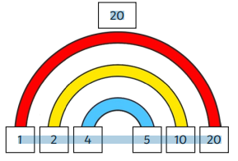
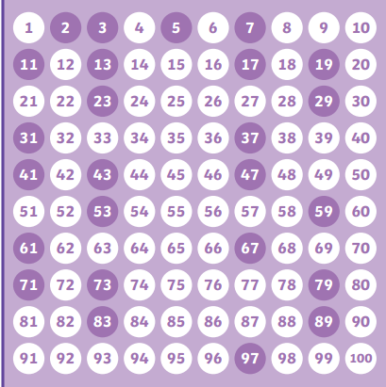
Multiples, Factors, Prime Numbers, Square and Cube Numbers.
Key Vocabulary
Multiple | A number that you get when you multiply a number by a positive integer. Multiples are extended times tables.
Factor | Factors are numbers that divide exactly into another number, without any remainders.
Prime Number | A number that is only divisible by 1 and itself.
Square Number | Multiply a number by itself.
Cube Number | Multiply a number by itself and by itself again.
Key Information
1 | Multiples are extended times tables. A multiple is a number that you get when you multiply a number by a positive integer.
2 | Factors are numbers that divide exactly into another number, without any remainders.
3 | A prime number is a number that is only divisible by 1 and itself.
4 | A square number is a number multiplied by itself.
5 | A cube number is a number that is multiplied by itself and by itself again.
Worked Examples
Multiples Multiples of 2 always end with a 2, 4, 6, 8 or 0. You can tell 2286, for example, is a multiple of 2 because it ends with a 6. The multiples of 5 are all the numbers in the 5 times table, such as 5, 10, 15, 20, 25 and so on. Factors The factors of 20 are 1, 2, 4, 5, 10 and 20. The factor pairs are: 1 and 20 2 and 10 Prime Numbers
Prior Knowledge
Y2 | Multiplication and Division​ | Know division facts for 2, 5s and 10s ​
Y3 | Multiplication and Division​ | Know division facts for 3s, 4s and 8s. ​
Y4 | Multiplication and Division​ | Know division facts up to 12 x 12.​
Y4 | Multiplication and Division​ | Know that factor pairs can be uses commutatively and can help support our mental calculations.​
Worked Examples
2² = 2 x 2 = 4 5² = 5 x 5 = 25 3³ = 3 x 3 x 3 = 27 4³ = 4 x 4 x 4 = 64

