Slide 1
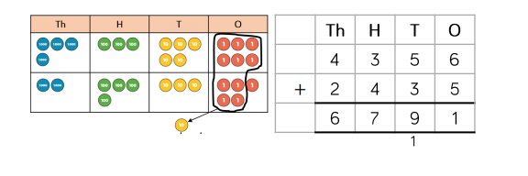
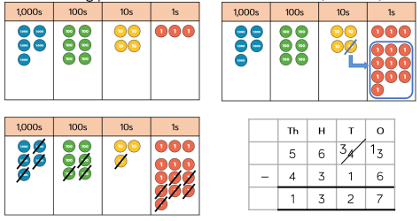

Number: Addition and Subtraction Knowledge Organiser
Key Vocabulary
Add | The operation of combining addends to find a sum or total.
Total | The sum found by adding
Addend | A number to be added to another.
Subtract | Finding the difference.
Minuend | A number from which another number is subtracted. E.g. 10-4=6. 10 is the minuend.
Subtrahend | A number to be subtracted from another. E.g. 10-4=6. 4 is the subtrahend.
Difference | The numerical difference between two numbers. You find the difference by subtracting. E.g. 10-4=6. 6 is the difference.
Key Information
1 | Knowledge of number bonds and place value can be used to add and subtract multiples of powers of 10. Children unitise to help them complete a calculation. For example, if they know that 3 + 5 = 8, then 3 thousand + 5 thousand = 8 thousand and 3,000 + 5,000 = 8,000
2 | When using the formal written method of addition and subtraction, always start in the ones column.
3 | When subtracting, always start with the greater number.
4 | The inverse of addition is subtraction.
5 | The inverse of subtraction is addition.
Worked Examples
4,356 + 2,435 5,643 – 4,316 Inverse Operations To check 53,476 – 32,732 = 20,744 use 32,732 + 20,744 = 53,476
Prior Knowledge
Y4 | Number: Addition and Subtraction | To add and subtract numbers with up to 4-digits using the formal written method.
Y3 | Number: Addition and Subtraction | To add and subtract numbers with up to 3-digits using the formal written method.
Y2 | Number: Addition and Subtraction | That addition can be done in any order but in subtraction, you must always start with the minuend (greatest number).

