Slide 1
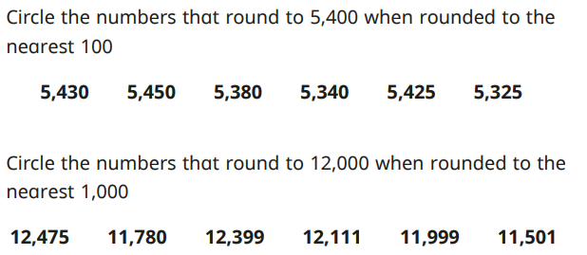
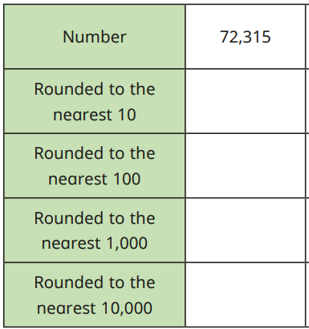
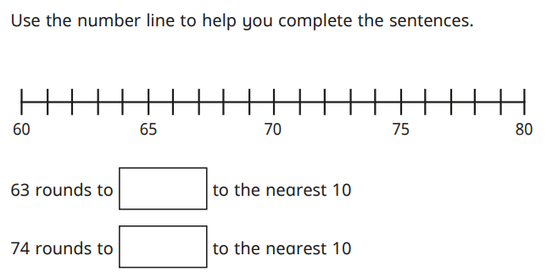
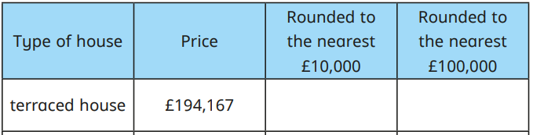
Place Value: Rounding to the nearest 10, 100, 1,000, 10,000 and 100,000. Knowledge Organiser
Key Vocabulary
Digit | Any of the numerals from 0-9.
Nearest | Closest to.
Place value | The value of a digit according to its position in the number: ones, tens, hundreds, thousands, tens of thousands, hundreds of thousands, millions.
Key Information
1 | 1, 2, 3, 4 round down 5, 6, 7, 8, 9 round up.
2 | When rounding to the nearest 10, look at the ones column. When rounding to the nearest 100, look at the tens column. When rounding to the nearest 1000, look at the hundreds column. When rounding to the nearest 10,000, look at the thousands column. When rounding to the nearest 100,000, look at the tens of thousands column.
Worked Examples
Worked Examples
72,320
72,300
72,000
Prior Knowledge
Y4 | Place Value | To round numbers to the nearest 10, 100 and 1,000.
70,000
60
70
£190,000
£200,000

