Slide 1
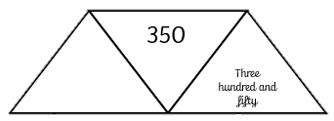
Number and Place Value: Roman Numerals Knowledge Organiser
Key Vocabulary
I | 1 one
II | 2 two
III | 3 three
IV | 4 four
V | 5 five
VI | 6 six
VII | 7 seven
VIII | 8 eight
IX | 9 nine
X | 10 ten
L | 50 fifty
C | 100 one hundred
D | 500 five hundred
M | 1000 one thousand
Key Information
1 | If a smaller symbol appears after a larger symbol, you add them together. E.g. VI = V + I = 5 + 1 = 6.
2 | If a smaller symbol appears before a larger symbol, you subtract the,. E.g. IX = X – 1 = 10 – 1 = 9.
Worked Examples
Match the Roman Numerals to the numbers. DC 9 IX 400 CD 600 Complete the tables:
Prior Knowledge
4 | Number and Place Value: Roman Numerals | Roman Numerals up to 100.
10 | 20 | 30 | 40 | 50
X | XX | XXX | XL | L
Worked Examples
Complete the diagram using words, numerals and Roman Numerals.
Numerals | Words | Roman Numerals
52 | Fifty-two | L!!
635 | Six hundred and thirty-five | DCXXXV
CCCL

