Slide 1
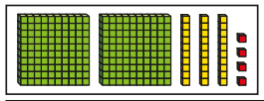

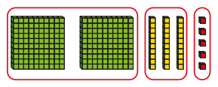
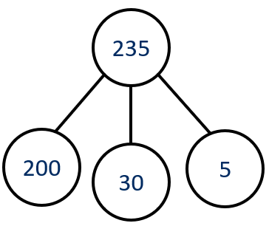
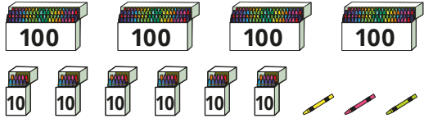
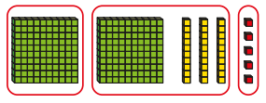
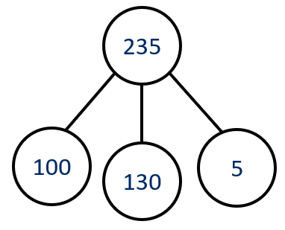
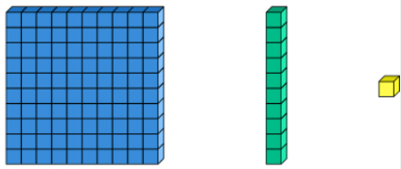

Number and Place Value: 100s, 10s and 1s - Knowledge Organiser
Key Vocabulary
Place value | The value of a digit in a number.
Thousand | The digit worth thousands – 1000
Hundreds | The digit worth hundreds - 100
Tens | The digit worth tens - 10
Ones | The digit worth ones - 1
Digit | Any numeral from 0 to 9.
Representation | Showing something in a certain way.
Partition | Divide into parts.
Base ten | 100 10 1
Place value counters
Key Information
1 | We can use base 10 or other pictorial representations to see that hundreds are 10 times the size of tens and tens are 10 times the size of ones.
2 | We can partition numbers in different ways.
3 | We use zero as a place holder if there are no tens or ones in a 3-digit number.
Worked Examples
What number is shown? 234 = Two hundred and thirty-four Partitioning and flexible partitioning There are 3 hundreds, 7 tens and 2 ones. The numbers is 372. 372 = 300 + 70 + 2 There are 2 hundreds, 3 tens and 5 ones. The number is 235. 235 = 200 + 30 + 5 235 = 100 + 130 + 5
Prior Knowledge
2 | Number and Place Value: 10s and 1s | Place value of each digit in a two-digit number (10s and 1s)
Worked Examples
Count in 100s. How many crayons are there? 463 = Four hundred and sixty-three

Slide 2
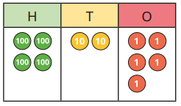
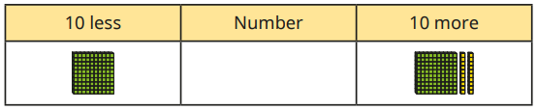

Number and Place Value: Finding 1, 10 and 100 more and less - Knowledge Organiser
Key Vocabulary
Place value | The value of a digit in a number.
Thousand | The digit worth thousands – 1000
Hundreds | The digit worth hundreds - 100
Tens | The digit worth tens - 10
Ones | The digit worth ones - 1
Digit | Any numeral from 0 to 9.
More than | 1, 10 or 100 bigger than a given number.
Less than | 1, 10 or 100 smaller than a given number.
Base ten | 100 10 1
Place value counters
Key Information
1 | To find more than a number, we add to our given number.
2 | To find less than a number, we takeaway from our given number.
Worked Examples
The place value chart shows 425. What is 1 less than 425? 424 What is 10 less than 425? 415 What is 100 less than 425? 325 Complete the table. The missing number is 110.
Prior Knowledge
2 | Number and Place Value: 1 more and 1 less | Children found 1 more and 1 less than a given number.
Worked Examples
Here are three numbers shown in base 10. Which picture shows 1 more than 236? C What is 1 more than 236? 237 Which picture shows 10 more than 236? A What is 10 more than 236? 246 Which picture shows 100 more than 236? B What is 100 more than 236? 336

Slide 3
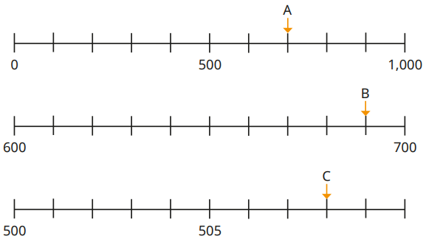

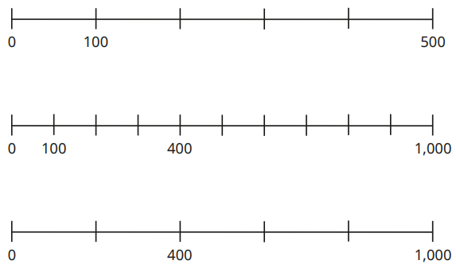
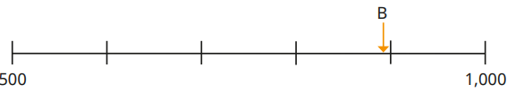

Number and Place Value: Number lines to 1,000 - Knowledge Organiser
Key Vocabulary
Place value | The value of a digit in a number.
Thousand | The digit worth thousands – 1000
Hundreds | The digit worth hundreds - 100
Tens | The digit worth tens - 10
Ones | The digit worth ones - 1
Digit | Any numeral from 0 to 9.
Number line | A tool used to assist with counting.
Estimate | A sensible guess.
Key Information
1 | Take note of the start and end point on each number line.
2 | Label the divisions on the number line to assist with interpreting the exact values positioned.
3 | Knowing the midpoint of intervals and which of the two divisions a number is closer to.
Worked Examples
What numbers are the arrows pointing to? A=700 B=690 C=508 Estimate the numbers the arrows pointing to. A = 750 B = 990-995 Estimate where the numbers belong on the number line. 250 550 990
Prior Knowledge
2 | Number and Place Value: Number lines to 100. | Children placed numbers from 0 to 100 on number lines and estimated the position of numbers on a number line.
Worked Examples
Complete the number lines:

Slide 4
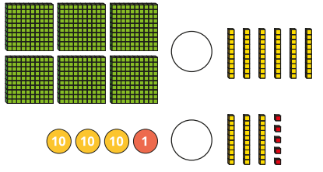

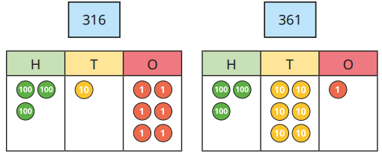

Number and Place Value: Compare and order numbers - Knowledge Organiser
Key Vocabulary
Place value | The value of a digit in a number.
Hundreds | The digit worth hundreds - 100
Tens | The digit worth tens - 10
Ones | The digit worth ones - 1
Compare | See which is bigger or smaller
Order | Place numbers in an order.
Ascending | From smallest to largest.
Descending | From largest to smallest.
Base ten | 100 10 1
Place value counters
Key Information
1 | Use concrete resources, pictorial representations, words and symbols to decide which is larger or smaller.
2 | Always start by comparing the largest place value (e.g. hundreds, then tens, then ones)
3 | Use knowledge of comparing numbers to support with ordering numbers correctly.
Worked Examples
Write <, > or = to make the statements correct. Write the numbers in order starting with the greatest. 442, 418, 397 Here are the heights of five children. Write the heights in ascending order. 119cm, 120cm, 121cm, 122cm, 124cm
Prior Knowledge
2 | Number and Place Value: Compare and order numbers | Children compared and ordered numbers from 0 to 100 using <, > and =.
Worked Examples
Which number is greater? 361 is greater than 316 because although they have the same number of hundreds, 6 tens is greater than 1 ten.

