Slide 1
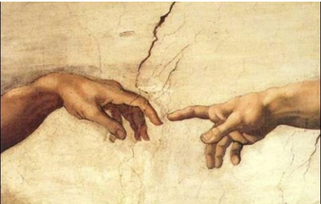
Key Vocabulary
Qualities | A distinctive attribute or characteristic possessed by someone, e.g. leadership qualities.
Talents | A natural aptitude or skill, e.g. a talent for drawing.
Unique | Being the only one of its kind – unlike anyone else.
Responsibility | Doing the right thing and being accountable for our own actions.
Peacemaker | A person who brings about peace. Someone who helps others to solve conflicts and reach a peaceful solution.
Image | We are in the image of God in our moral, spiritual and intellectual nature.
Ourselves Knowledge Organiser
Key Information
1 | I know Colossians 3: 10 -17, explores how Christians are called to live in peace.
2 | I know that people are made in the likeness and image of God (Genesis 1: 26-31).
3 | I know, Colossians 3: 10 -11 describes and show understanding of what Christians believe, feel and experience about uniqueness.
4 | I know how people are made in God’s image and likeness and how that might shape their lives through service as stated in Philippians 4: 4-9
Who Am I?
Prior Knowledge
3 | Reconciliation | We reconcile our sins before God so that we are free of the weight of sin before receiving Gods blessing.
1 | Families | God loves and cares for us all and all our families. Jesus was born into a human family.
2 | Beginnings | God was there at my beginning and the beginning of everyone and their family.
3 | Homes | God has a plan for everyone's family and we trust in this plan.
4 | People | Jesus family tree is made up of many people throughout the bible who all showed love to others.
Key Scripture Links
1 | Genesis 1: 26-31
2 | Colossians 3: 10-11
3 | Colossians 3: 12-17
4 | Philippians 4: 4-9
5 | Hosea 11: 1-4

