Slide 1

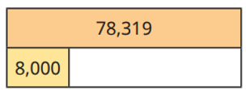
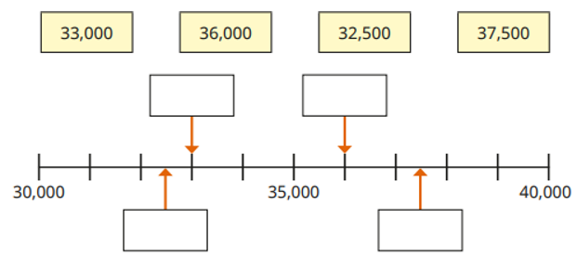
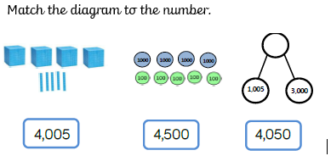
Number and Place Value: Numbers to 1,000,000 Knowledge Organiser
Key Vocabulary
Place value | The value of a digit according to its position in the number: ones, tens, hundreds, thousands, tens of thousands, hundreds of thousands, millions.
Digits | Any of the numerals from 0-9.
Add | To join numbers together so that they increase in size.
Subtract | To take away one amount from another to find the difference.
More | A greater amount.
Less | A smaller amount.
Figures | A number.
Words | To write a number without numerals, e.g. 12,546 = twelve thousand, five hundred and forty six.
Represent | To show a number.
Value | How much something is worth.
Key Knowledge
1 | To be able to represent numbers using concrete and pictorial methods.
2 | To be able to add and subtract 1, 10, 100 and 1000 from a given number.
3 | To be able to identify the value of each digit in a number up to 1,000,000.
4 | To be able to represent numbers in figures and words up to 1,000,000.
Worked Examples
Complete the table. Complete the bar model. 438,396 = 400,000 + 30,000 + 8,000 + 300 + 90 + 6 What is the value of the underlined digit? 7,131,491 = 100,000
5,383
5,473
6,373
Prior Knowledge
3 | Number and Place Value | Represent and partition numbers up to 1,000.
4 | Number and Place Value | Represent and partition numbers up to 10,000.
70,319
Worked Examples
Match the representations to the numbers.
33,000
36,000
32,500
37,500

