Slide 1
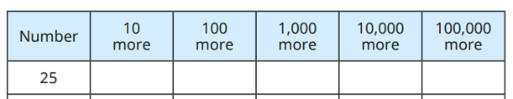
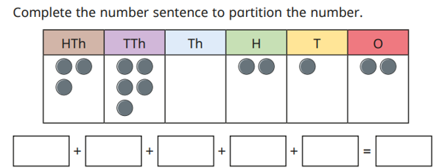

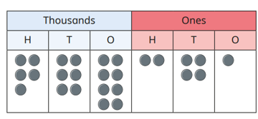
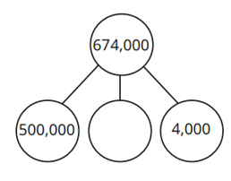
Place Value: Finding 10, 100, 1000, 10000 and 100000 more or less. Partitioning numbers to 1,000,000 Knowledge Organiser
Key Vocabulary
More | A greater amount.
Less | A smaller amount.
Partition | A way of splitting numbers into smaller parts.
Digit | Any of the numerals from 0-9.
Add | To join numbers together so that they increase in size.
Subtract | To take away one amount from another to find the difference.
Place value | The value of a digit according to its position in the number: ones, tens, hundreds, thousands, tens of thousands, hundreds of thousands, millions.
Key Information
1 | Children to use their place value knowledge to find numbers 10, 100, 10000, 100000 more or less than a given number,
2 | To extend understanding of partitioning to deal with larger numbers introduced this year.
Worked Examples
Complete the table: Write the next 6 numbers in the sequence. Count up in 1,000s starting from 2,370 3,370, 4,370, 5,370, 6,370, 7,370, 8,370 Complete the part-whole model.
35
125
1,025
10,025
100,025
Prior Knowledge
Y3 | Place Value | To find 10 or 100 more or less than a given number.
Y3 | Place Value | To partition three-digit numbers.
Y4 | Place Value | To partition four-digit numbers.
Y4 | Place Value | To find 1000 more or less than a given number.
Worked Examples
Complete the number track:
300,000
40,000
200
10
2
340,212
27
57
The number 568,241 is shown.
What is 100 more?
568,341
170,000

