Slide 1
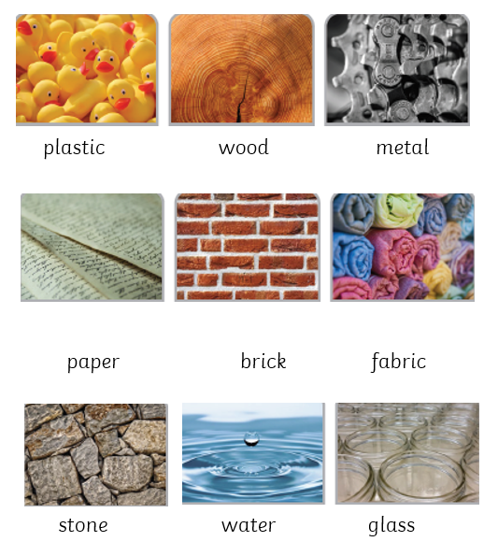
Materials Knowledge Organiser
Key Vocabulary
object | A thing that can be used.
material | What an object is made from.
hard | Not easily broken or bent.
soft | It is easy to cut, fold or change the shape of.
stretchy | Can be pulled to make it longer or wider.
transparent | An object which can be seen through.
opaque | Objects which cannot be seen through.
dull | Doesn’t reflect light. Does not look bright or shiny.
shiny | Reflects light easily.
rough | It feels and looks uneven or bumpy.
smooth | Has no lumps or bumps.
Key Information
1 | Metal, wood, brick, paper, fabric, glass and plastic are everyday materials.
2 | We can describe rocks by the texture, shape and colour.
3 | There is a difference between objects and the materials they are made from. Some objects can be made from more than one material.
4 | Melting and freezing are reversible changes and are affected by temperature.
5 | Some items sink and some float. It is not the objects size which causes it to sink or float.
6 | Some materials absorb water.
Prior Knowledge
F1 | Knows how to use all their senses in hands-on exploration of natural materials.
F2 | Knows how to describe what they see, hear and feel whilst outside.

