Slide 1
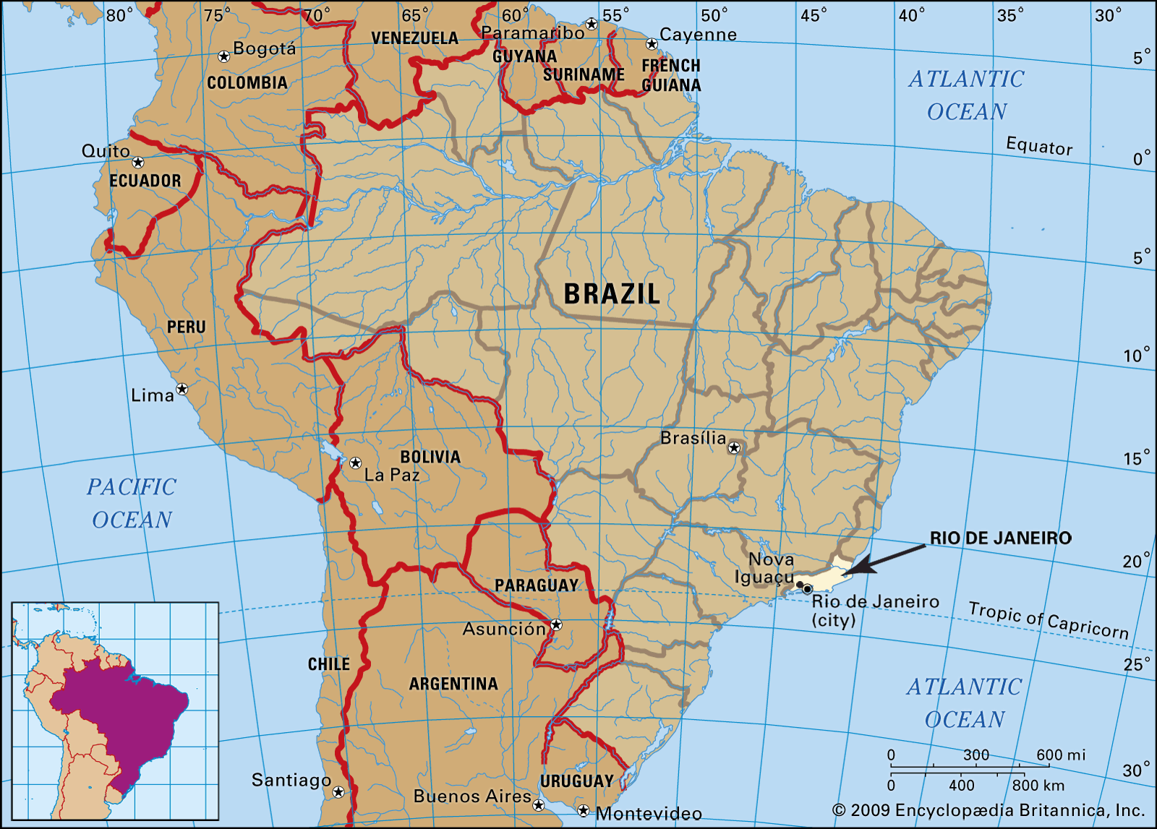
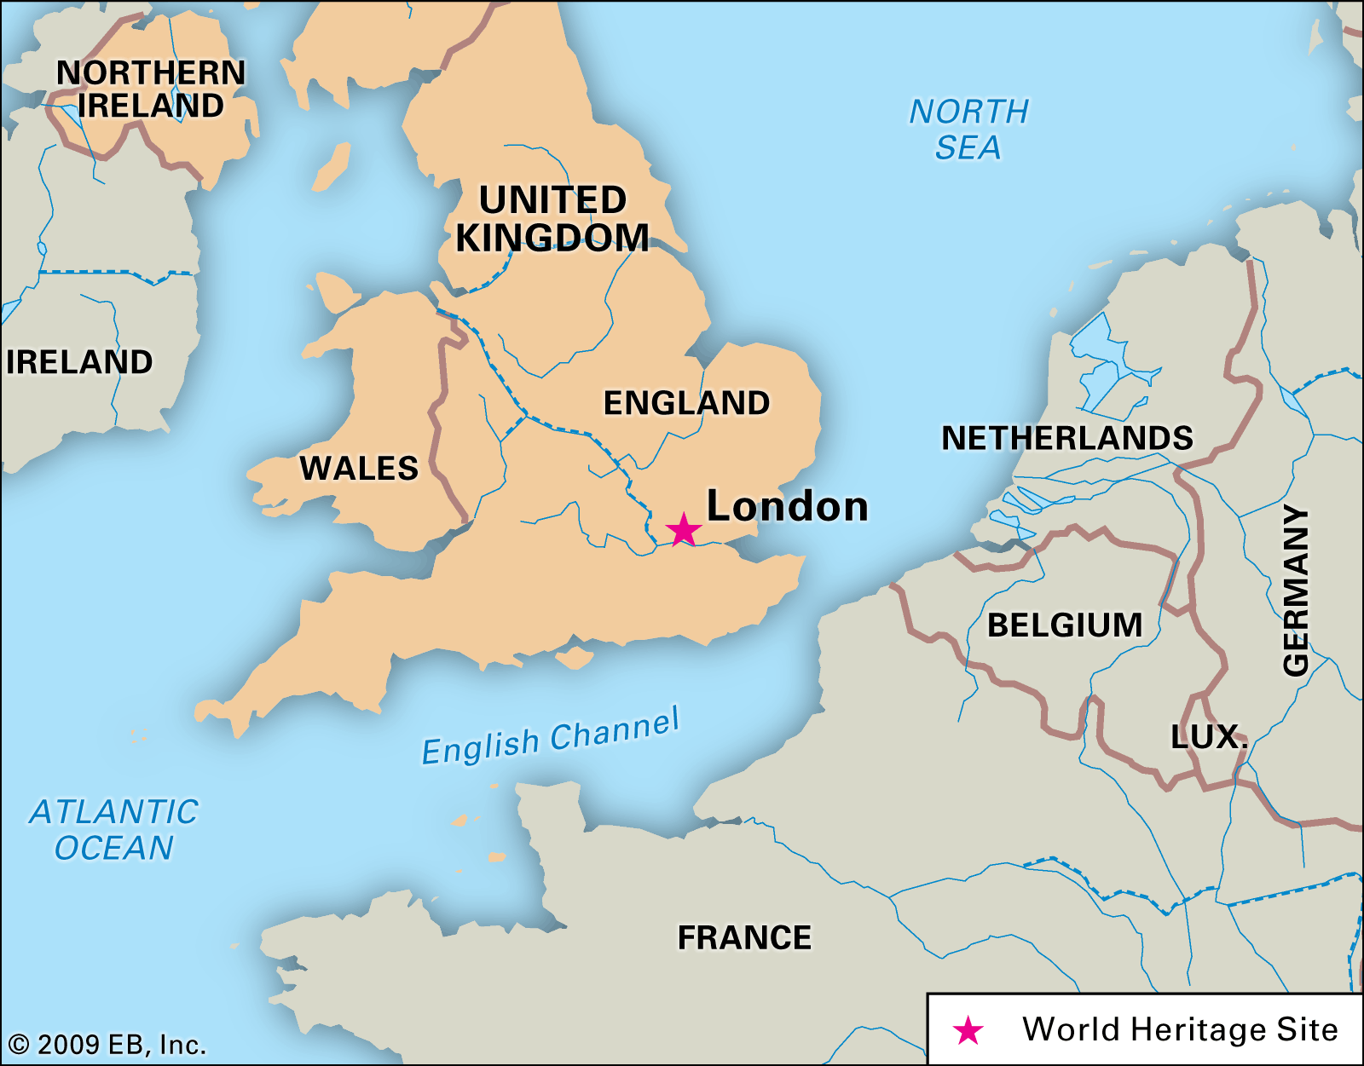
London to Rio Knowledge Organiser
Key Vocabulary
Biome | Areas of the planet with similar climate and landscape, where similar animals and plants live.
Tropical rainforest | Tropical rainforests are very hot, humid and wet. There are no seasons; the weather is consistent all year round.
Deciduous forest | A biome dominated by deciduous trees which lose their leaves seasonally.
Taiga | The taiga is the driest and coldest forest biome. They are located in the far north, including northern Russia, Siberia, Canada, Alaska, Finland, Norway and Sweden.
Tundra | This biome is found in some of the coldest regions of the world. It is a vast, frozen and treeless landscape.
Savannah | Savannahs are flat grasslands with scattered trees and shrubs. They’re usually found near to the equator.
Desert | Deserts are extremely dry environments that are home to well-adapted plants and animals.
Climate zone | Climate zones are areas with distinct climates.
Key Information
1 | South America is in both the Northern and Southern Hemisphere, with the Equator running directly through the continent. The Tropic of Capricorn also runs through South America.
2 | Rio de Janeiro is the capital city of Brazil in South America and is located on the coastline of Brazil in the Southern Hemisphere.
3 | Biomes are large areas, or ecosystems, of the earth that have similar weather, climates, landscapes, animals and plants. Some of the worlds biomes are: desert, forest, grassland, Mediterranean Mountain, Polar, Tundra
4 | Rio is in an Atlantic Forest Biome.
5 | Rio de Janeiro has a tropical and subtropical climate and a tropical forest vegetation belt.
6 | Rio in Brazil is on the Southern Hemisphere, so the seasons are opposite from England which is in the Northern Hemisphere
7 | Know the biome for the London in the UK is a temperate deciduous forest.
8 | Know the temperate climate is reasonably stable with not great variation throughout the year. Deciduous forests are those that have trees with broadleaves (e.g. Oak) that are shed in the autumn months.
9 | Know that London is slightly larger than Rio and has a larger population, but both have a high population to fit into the city.
10 | Know that in both London and Rio there is a lack of housing for people so good housing in the centre is expensive which leads to poorer areas of cheap overcrowded housing e.g. favelas in Rio.
Prior Knowledge
1 | Y1 Coastlines | A coastline is the land around the edge of land that touches the sea.
2 | Y1 Bright Lights, Big City | To know some famous London landmarks and their location.
3 | Y4 Road Trip USA | The location of America, hemispheres, tropics, latitude and longitude.
4 | Y4 Misty Mountain Sierra | Mountains are higher and steeper than hills – more than 600m above sea level.

