Slide 1
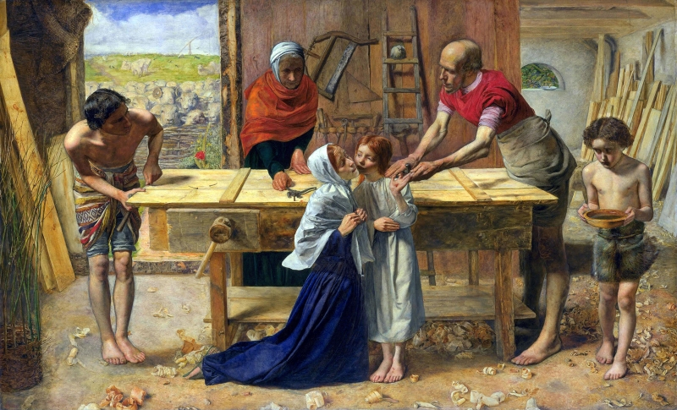
Key Vocabulary
home | The place where someone lives, especially as a member of a family or household.
love | An intense feeling of deep affection.
family | A group of one or more parents and children living together.
difference | A point or way in which things are not the same.
respect | A feeling of admiration or regard for someone’s feelings, wishes and rights.
joys | A feeling of pleasure and happiness.
sorrows | A feeling of sadness.
community | A group of people living in the same place or have something in common.
Homes Knowledge Organiser
Key Information
1 | St. Paul’s letter to the Romans 12:8-13 ‘Be real about loving’ teaches us the positive ways to create a happy home and a Christian community.
2 | St. Paul’s letter to the Ephesians 5:1-9 and 6:1-4 offers advice on how parents and children should show mutual love and respect in their home.
3 | Millais’ Carpenter Shop portrays the ways in which Mary and Joseph were loving parents towards Jesus.
4 | St. Paul taught the Romans the importance of prayer and that we should pray regularly as he is always with us.
5 | Colossians 3:12-17 offers us the advice and encouragement of how to behave that St. Paul gave the people of Colossae.
6 | God has a vision for every family and that is taught through the words and phrases within the scripture.
What makes a house a home?
Key Scripture Links
1 | Romans 12:8-13
2 | Ephesians 5:1-9
3 | Ephesians 6:1-4
4 | Luke 2:39-40
5 | John 13:34-35
6 | Colossians 3:12-17
Prior Knowledge
1 | Families | God loves and cares for us all and all our families. Jesus was born into a human family.
2 | Beginnings | God was there at my beginning and the beginning of everyone and their family.

