Slide 1
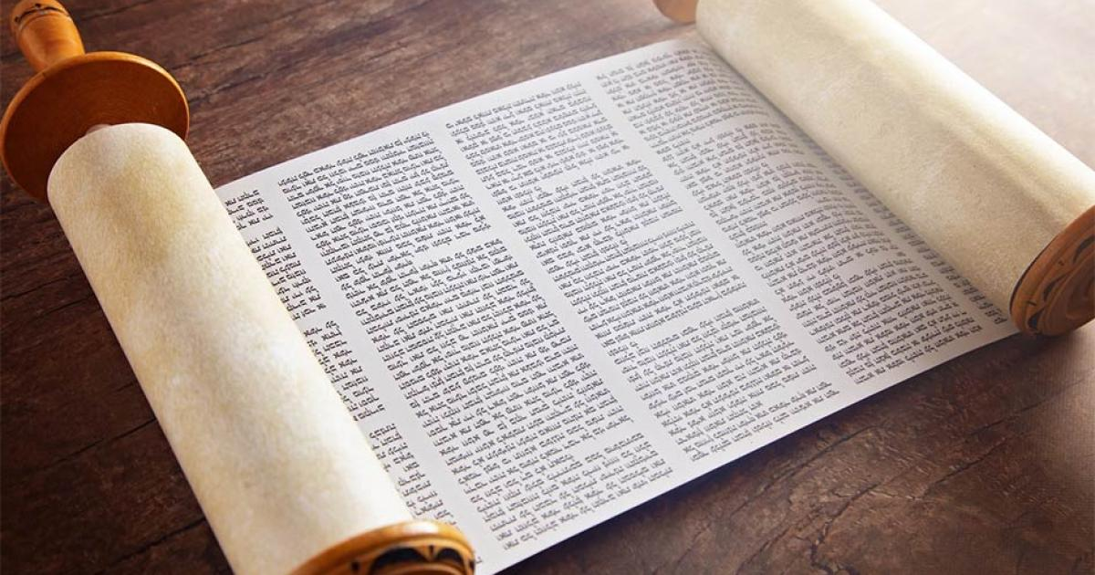
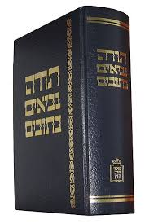
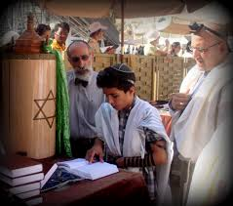
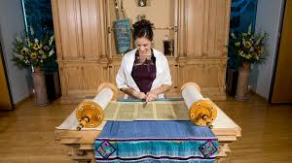
Key Vocabulary
Synagogue | Jewish place of worship.
Rabbi | The Jewish religious leader.
Tanakh | The Hebrew Bible
Torah | The first five books of the Hebrew Bible.
Yad | Silver pointer used to turn the pages of the Torah.
Bar/Bat Mitzvah | A ceremony where children transition into religious adulthood.
Judaism
Key Information
1 | The Tanakh is the Hebrew Bible. It is made up of; the Torah, the Prophets and the Writings.
2 | The Writings include the Psalms while the Torah is a collection of laws, commandments, rules and stories.
3 | The Torah contains 5 books; Genesis, Exodus, Leviticus, Numbers and Deuteronomy.
4 | The Torah is very special and the Jewish people consider it to be the greatest gift God has given them.
5 | The Torah is written by hand in Hebrew. It is written from right to left. It cannot be touched by hand and so a yad is used to change pages.
6 | Bar/Bat Mitzvah is a religious ceremony where Jewish boys (aged 13) and girls (aged 12) become full members of the Jewish community.
Holy Books – The Torah
Prior Knowledge
EYFS | Hanukah | This is the Jewish festival of lights and tells people the story of the oil in the lamp in the temple.
1 | Abraham and Moses | Abraham and Moses were the leaders of the Jewish people and led the people to safety with the help of God
2 | Shabbat | Shabbat is the day of God and is a day of rest for Jewish people. This is on a Friday and families come together for a special meal.
3 | The Synagogue | A epical building where the Jewish community meet to pray, study and celebrate. If possible, they are built facing the Temple in Jerusalem. Boys and men wear a kippah while women often ware a tallit.

