Slide 1
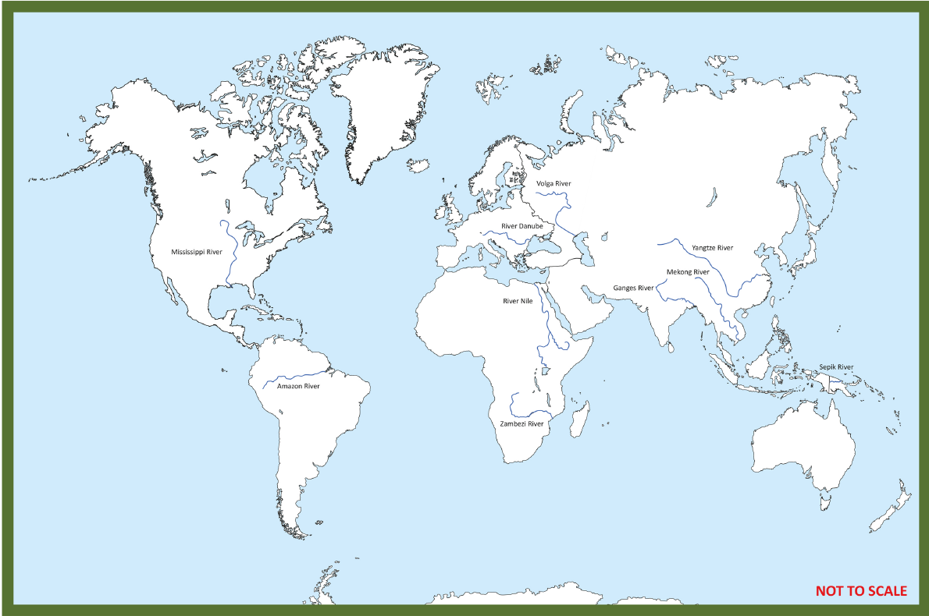
Flow Knowledge Organiser
Key Vocabulary
Deposition | The laying down of sediment carried by wind, flowing water, the sea or ice.
Erosion | The process of soil and stone being gradually damaged and moved away by water, wind or rain.
Geographical | Based on or derived from the physical features of an area.
Human geography | Deals with how human activity affects or is influenced by the earth’s surface.
Physical geography | Geography that deals with natural features.
Region | An area, especially part of a country or the world having definable characteristics but not always fixed boundaries.
Settlement | A place where people establish a community.
Topographical | The study of forms and features of land surfaces.
Water cycle | The cycle of processes by which water circulates between the earth’s oceans, atmosphere and land.
Key Information
1 | The Nile is the longest river in the world and it is located in Africa. The second longest is the Amazon, South America and the third longest is the Yangtze in Asia.
2 | There are three stages to a river’s journey; the upper course, the middle course and the lower course.
3 | A river’s journey starts at high ground (source) and flows downwards to the sea (mouth).
4 | A meander is formed with erosion on the outside of the bend and deposition of mud and silt on the inside of a bend.
5 | The water cycle is a process that moves water around the Earth. It contains four stages; evaporation, condensation, precipitation and transportation or collection.
6 | There are nine geographical regions of England. We live in the Midlands.
7 | The River Thames is the longest river in England and the Trent is the second longest river in England runs through Nottingham.
8 | Historically, people settled by a river for; fresh water, farming, trade and defense.
9 | Now, people settle by rivers for the leisure activities, sightseeing of tourist attractions, bars and restaurants.
10 | There are positives and negatives for the leisure activities. The positives include; enjoyment, provides physical activity, good for well-being, brings money in. The negatives include; litter, pollution, harms wildlife and their habitats.
Prior Knowledge
1 | Y1 My World and Me | The River Trent is the main river through Nottingham and the River Maun is a river in their locality.
2 | Y1 My World and Me | The River Trent flows from a high point down to the North Sea.
3 | Y1 Bright lights, big city | Physical features of the Earth include; seas, mountains and rivers. The River Thames is in London.
4 | Y1 Coastlines | Rivers flow into the sea at different points along the coast.
5 | Y2 Poles Apart | The Equator goes around the middle of the Earth.
6 | Y2 Sail the Seven Seas | The seven continents are; Europe, North America, South America, Africa, Asia, Australia and Antarctica. The five oceans are; Pacific Ocean, Atlantic Ocean, Indian Ocean, Southern Ocean, Arctic Ocean.

