Slide 1
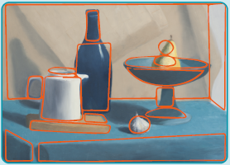
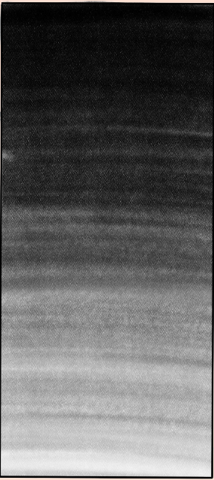
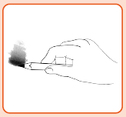
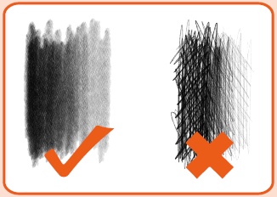
Key Vocabulary
abstract | Art where the subject doesn’t necessarily look like it does in real life.
botanical art | To depict whole plants or parts of plants that is visually pleasing and scientifically accurate.
composition | Putting different elements together in a pleasing way.
geometric | A regular shape with angles and straight lines.
organic | Irregular natural shapes.
scale | The size of what is being drawn.
shading | Drawn marks to show areas of light and dark.
texture | A surface quality that is not flat.
tone | The light and dark something is.
Art – Drawing
Knowledge Organiser
Key Knowledge
1 | We can use shapes to form the basis of our drawing.
2 | Organic shapes are those that are irregular, natural shapes and geometric are regular shapes with angles and straight lines.
3 | Tone refers to the light and dark areas of an object or artwork.
4 | Shading helps make objects look more realistic.
5 | You use the side of a pencil to shade and add tone.
6 | There are four rules of shading; one direction, no gaps, work neatly to the edges and create smooth even tones.
7 | Frottage is the technique of taking a rubbing from a textured surface.
8 | Paintings or drawings that look different to real life are called abstract art.
Prior Knowledge
1 | Year 1 | An outline is a joined up line creating a 2D shape.
2 | Year 1 | Drawing tools can create different marks.
3 | Year 1 | You can draw different types of lines.
4 | Year 1 | ‘Texture’ is what something feels like
5 | Year 1 | Different marks can be used to represent different textures of objects.
Key Artists
Max Ernst – created the technique ‘frottage’ Carl Linnaeus and Charles Darwin – created botanical illustrations. Georgia O’Keefe – famous for close up flower paintings creating abstract compositions.

