Slide 1
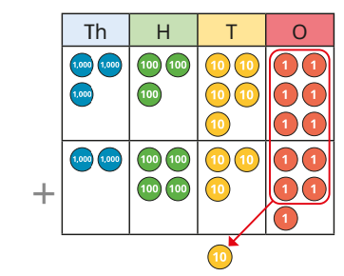
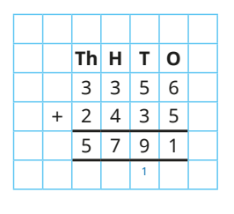
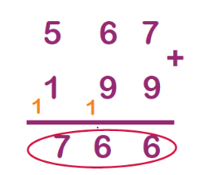
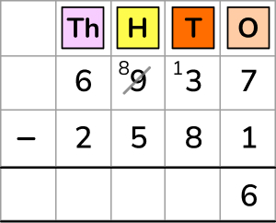
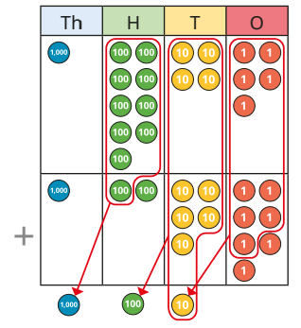
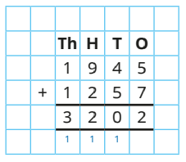
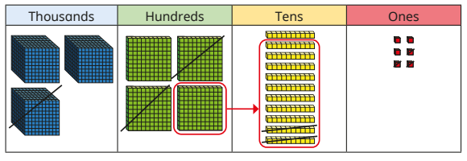
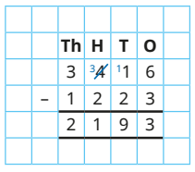
Addition and Subtraction: Add Two 4-Digit Numbers
Key Vocabulary
Addition | Used to find the total of two or more values.
Column method
Digit | Any of the numerals from 0-9.
Exchange | Used in adding when the total is over 9. Used in subtraction when there is not enough to take away from.
Subtraction | Used to take one amount away from another amount.
Key Information
1 | Digits must be placed in the correct place value columns.
2 | If a place value column adds to more than 9, 90 or 900, you must exchange into the column to the left.
3 | If you cannot subtract because there is not enough, you must exchange by ‘borrowing’ 1000, 100 or 10 from the column to the left.
Worked Examples
Addition: 3356 + 2435 OR 1945 + 1257 OR
Subtraction: 3416 – 1223 OR
Prior Knowledge
Year 2 | Number: Addition and Subtraction | Adding and subtracting across tens.
Year 3 | Number: Addition and Subtraction | Using the column method to add and subtract 3-digit numbers, with exchanges.
Year 4 | Number: Place Value | 4-digit numbers can be partitioned into thousands, hundreds, tens and ones.

Slide 2
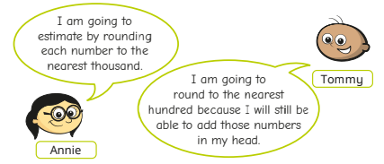
Addition and Subtraction: Estimating
Key Vocabulary
Estimation | A rough calculation. Rounding can be used to make an estimation.
Multiples | Numbers in a times table. For example, multiples of 3 include: 3 6 9 12 and so on…
Place holder | A 0 which is worth nothing on its own, but changes the value of other digits.
Rounding | Making a number simpler, but keeping it close to what it was.
Key Information
1 | To round to the nearest ten, look at the ones digit.
2 | To round to the nearest hundred, look at the tens digit.
3 | To round to the nearest thousand, look at the hundreds digit.
4 | If the digit is 0, 1, 2, 3 or 4, round to the current ten/hundred/thousand.
5 | If the digit is 5, 6, 7, 8 or 9, round to the next ten/hundred/thousand.
6 | Replace digits after the column that you have rounded with a placeholder. Keep all previous digits the same.
7 | To estimate, round the numbers before adding or subtracting them.
Worked Examples
Rounding: 8592 rounded to the nearest 10 → 8590 8592 rounded to the nearest 100 → 8600 8592 rounded to the nearest 1000 → 9000 Estimating: 3219 + 5624
Prior Knowledge
Year 3 | Number: Addition and Subtraction | Estimating using number lines.
Year 4 | Number: Place Value | Number lines show where numbers are placed in relation to other numbers.
Year 4 | Number: Place Value | Rounding is used to make a number simpler.
3219 → 3000
5624 → 6000
3000 + 6000 = 9000
3219 → 3200
5624 → 5600
3200 + 5600 = 8800

Slide 3
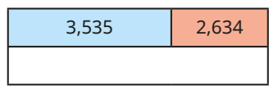
Addition and Subtraction: Checking Strategies using Inverse
Key Vocabulary
Fact families | Groups of calculations which use the same numbers. For example: 452 + 188 = 640 188 + 452 = 640 640 – 452 = 188 640 – 188 = 452
Inverse | Addition is the inverse of subtraction. Subtraction is the inverse of addition. Multiplication is the inverse of division. Division is the inverse of multiplication.
Operation | The four operations are addition, subtraction, multiplication and division.
Key Information
1 | Round the numbers in your calculation, then work it out. If your real answer is very far from your estimated answer, it could be incorrect.
2 | In addition, it does not matter which way around the numbers are. In subtraction, it does matter – the numbers cannot be swapped around.
3 | Use the inverse operation to your original calculation, then work it out. If you do not get the other number in the fact family as your answer, there is a mistake somewhere.
Worked Examples
I think that 345 – 46 = 289. Therefore, 289 – 46 SHOULD equal 345. 2 8 9 4 6 2 4 3 I got the answer 243. This means one of my answers is incorrect!
3535 + 2634 = 6169
2634 + 3535 = 6169
6169
6169 – 3535 = 2634
6169 – 2634 = 3535
Prior Knowledge
Year 1 and Year 2 | Number: Addition and Subtraction | The order of addition does not matter. The order of subtraction does matter.
Year 3 | Number: Addition and Subtraction | Inverse operations.
Year 4 | Number: Addition and Subtraction | The column method can be used to add and subtract numbers.

