Slide 1
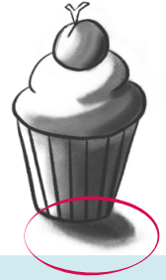
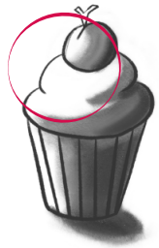
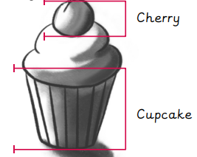
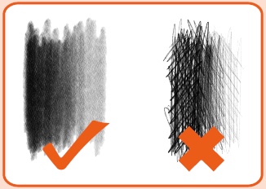
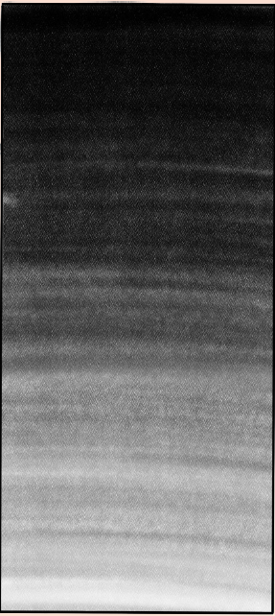
Key Vocabulary
composition | Arranging different materials together and sticking them to a surface.
highlight | A bright spot or area that makes something stand out or look shiny.
proportion | How big one element of an artwork appears compared to the whole thing.
shadow | A dark shape that appears when something blocks the light.
texture | The way that something feels when it is touched. E.g. fluffy, sticky, smooth.
tone | How light or dark something is.
Art – Drawing
Knowledge Organiser
Shadow
Highlight
Proportion
Key Knowledge
1 | Areas where the light reaches are called highlights and where they don’t reach are called shadows. You can use a rubber or the colour white to show highlights and darker colours to show shadows.
2 | You can change the tone by applying varying pressures when shading. The more pressure you apply, the darker the tone.
3 | Lines, mark making and colour can be used to show texture.
4 | Cross-hatching can also be used to show texture. The closer the lines are together, the darker the tone will be.
5 | Drawing in proportion helps to make things look more realistic.
6 | A good composition is balanced and has a focal point. You could tear, crumple and overlap pieces to create balance.
7 | Layering different colours together can make stronger and deeper shades and make drawings more interesting.
Shading
Tone
Prior Knowledge
1 | Year 1 - drawing | You can use a range of tools to make different marks and lines.
2 | Year 1 - drawing | ‘Texture’ is what something feels like.
3 | Year 3 - drawing | Shapes can be used to form the basis of drawings.
4 | Year 3 - drawing | There are four rules of shading.
5 | Year 3 - drawing | Tone refers to the light and dark areas of art or an object.
Key Artists
Sarah Graham – a British, still life artist known for her paintings. Nicola McBridge – a Scottish artist known for her ballpoint pen art. Inspired by food and retro objects and has products including; mugs, coasters and tea towels. Joel Penkman – a New Zealand artist living in England. Likes to paint still life and food.

