Slide 1
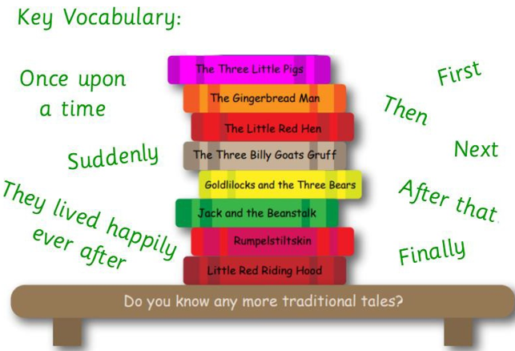
Key Vocabulary
Traditional Tale | A traditional tale is a story which has been retold for many years.
Finger spaces | Finger spaces are used between words so each word stands on its own and has its own meaning.
Sentence | A set of words that is complete in itself. They have a subject, predicate and stop.
Traditional Tales
Worked Examples
Finger spaces: Create a space in between words in a sentence. Little Red Riding Hood walked to granny’s house.
Finger spaces: Correct this sentence so that there are clear finger spaces. Thefoxategranny. The fox ate granny.
Prior Knowledge
F2 | Pentecost 2 | Write simple phrases which can be read by others. Write recognisable letters, most of which are formed correctly.
F1 | Pentecost 2 | Write some letters correctly
Key Information
1 | Finger spaces are used in between each word in a sentence.
2 | A sentence has a subject, predicate and a way of stopping the sentence. We are using full stops.

