Slide 1
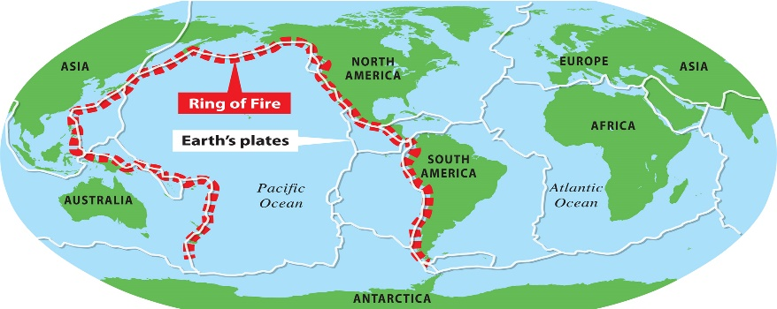
Tremors Knowledge Organiser
Key Vocabulary
epicentre | The exact location on the Earth’s surface that is directly above an earthquake.
fault line | A break in the Earth’s crust.
lava | Hot, molten rock that comes out of a volcano or the solid rock formed when it cools.
magma | Hot molten rock found in the Earth’s mantle
Richter scale | A mathematical scale (1-10) used by scientists to describe the size of an earthquake.
seismometer | A device used to measure and record the strength and duration of an earthquake
tectonic plate | A large, moving piece of rock that makes up the Earth’s crust.
vent | An opening in the Earth’s crust through which lava escapes.
Key Information
1 | The Earth is made of four layers; the crust, the mantle, the outer core and the inner core.
2 | A volcano is a hill or mountain with an opening in the Earth’s crust that allows magma, gas and ash to reach the surface.
3 | There are two types of volcanic eruption; effusive and explosive. In both eruptions, magma rises from the mantle, into the magma chamber and when the pressure increases it erupts producing lava and ash.
4 | There are four types of volcano; stratovolcano, shield volcano, cinder cone volcano and lava dome volcano. They can be classified in three ways; active, dormant or extinct.
5 | The Ring of Fire is a large area around the Pacific Ocean where many volcanoes and earthquakes occur.
6 | Where two tectonic plates meet is called a plate boundary and it is movement at these plate boundaries that causes volcanoes and earthquakes.
7 | Earthquakes occur when two tectonic plates push into each other, pull apart from one another or slide alongside each other.
8 | The tectonic plate movement causes seismic waves with the centre of an earthquake called the epicentre. An earthquake is measured using the Richter scale.
9 | An earthquake is a natural disaster because it is caused by nature, affects many people and causes widespread damage.
10 | Earthquakes can cause short term problems including; injury from falling debris, loss of shelter and personal items and can cause long term problems including; loss of homes, lack of clean water and sanitation, damaged roads and transport and loss of jobs and services.
Prior Knowledge
1 | Year 1 – Bright Lights, Big City | Physical features include; mountains, rivers and seas.
2 | Year 1- Bright Lights, Big City & Coastlines | Identifying physical features on a map including; land, oceans, seas and rivers
3 | Year 1 – Coastlines & Year 2 – Poles Apart | Use the four points of a compass to describe the location of features on a map.
4 | Year 2 – Poles Apart | The location of the Equator, the North and South Pole on a globe
5 | Year 2 – Sail the Seven Seas | The names and locations of the 7 continents of the world and the 5 oceans of the world.
6 | Year 3 - Flow | Locate the Equator, the North and South poles and the Northern and Southern hemispheres on a world map.

