Slide 1
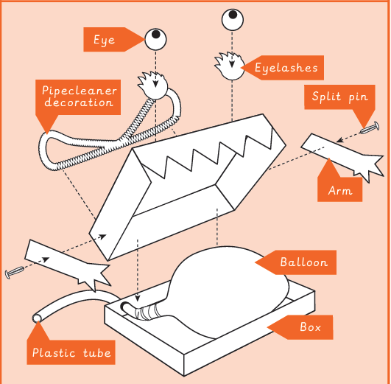
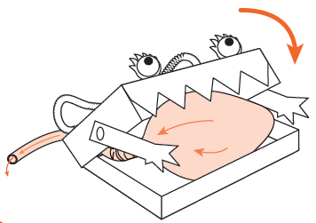
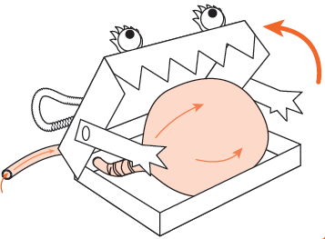
Key Vocabulary
exploded-diagram | A diagram which shows all of the parts of a product, including the internal and external parts.
function | How something works
mechanism | the parts of an object that move together as part of a machine
motion | the movement an object makes when controlled by an input or output (e.g. left, right, up, down)
output | output is the motion that happens as a result of starting the input
pneumatic system | a mechanism that runs on air or compressed gas
thumbnail sketch | small drawings to get ideas down on paper quickly
D&T
Mechanical systems – pneumatic toy
Knowledge Organiser
Exploded diagrams allow us to see how a product is put together and the different components inside.
Key Knowledge
1 | A mechanism is a system of parts which work together to create movement.
2 | Pneumatic systems can be used as part of a mechanism and force air over a distance to create movement.
3 | Design criteria are a set of rules/instructions to follow.
4 | Different types of drawings are used in design to explain ideas more clearly.
5 | Thumbnail sketches are quick and small and are good for making sense of your ideas.
6 | Exploded diagrams show how different parts of a product fit together, giving a clear idea of how to create the product.
7 | We can use a net to build the secure housing for the pneumatic system.
8 | Syringes and balloons can be used to create different types of pneumatic systems.
When air exits the balloon, the monster’s mouth closes.
When air enters the balloon, the monster’s mouth opens.
Prior Knowledge
1 | Year 1 - mechanisms | A wheel needs to be round and to move, needs to be attached to a rotating axel. An axel moves within an axel holder which is fixed to the vehicle or toy.
2 | Year 2 - mechanisms | Different materials have different properties and therefore have different uses.

