Slide 1
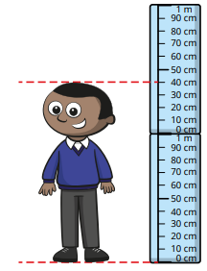


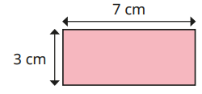


Measurement - Length and Perimeter - Knowledge Organiser
Key Vocabulary
Metres (m) | A unit of measurement. Used to measure the length or distance.
Centimetres (cm) | A unit of measurement. Used to measure the length or distance.
Millimetres (mm) | A unit of measurement. Used to measure the length or distance.
Height | How tall an object is, measured from bottom to top.
Length | How long something is or the distance between two points.
Width | How wide something is, measured from side to side.
Perimeter | The total distance around the outside of a shape.
Key Information
1 | We use a ruler to measure objects in cm and mm. We can use a metre stick or tape measure to measure in m.
2 | 1 metre is equivalent to 100 centimetres. 1 centimetre is equivalent to 10 millimetres.
3 | We use <, > and = when comparing measurements
4 | Perimeter is the distance around the outside of a closed 2D shape.
Worked Examples
How tall are they? 1m and 40cm. Equivalent lengths. Complete the bar models. 4m = 400 cm 6cm = 60mm Add and subtract lengths 7cm + 30mm = 7cm + 3cm = 10cm 1m – 42cm = 100cm – 42cm = 58cm Perimeter Find the perimeter of the rectangle. 7cm + 7cm = 14cm 3cm + 3cm = 6cm 14cm + 6cm = 20cm The perimeter of the rectangle is 20cm.
Prior Knowledge
1 | Measurement: Length and height | Compare objects using longer, shorter and taller. Measure objects using a ruler in cm.
2 | Measurement: Length and height | Measure using a ruler in cm. Measure using a metre stick and tape measure in m. Compare and order lengths. Apply the four operations to measurements.
Worked Examples
Measure in metres, centimetres and millimetres. What is the length of the line? 7cm. What is the length of the line? 15mm

