Slide 1
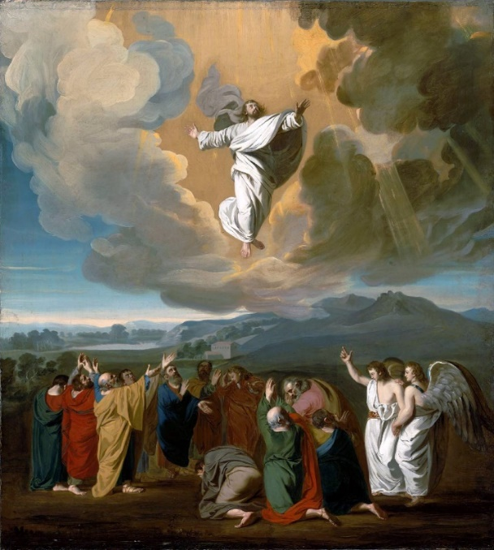
Key Vocabulary
fire | The symbol and presence of power and energy from the Holy Spirit.
warmth | Symbolises the Holy Spirit.
wind | Symbolises the Holy Spirit, representing God’s beath of life, the Spirit’s power and presence.
energy | The fire and wind of the Holy Spirit.
power | The power of the Holy Spirit.
gifts | The people received the gifts of the Holy Spirit.
Holy Spirit | God’s presence and power that was received on Pentecost day.
Rosary | A special prayer used to honour Mary.
Glorious Mysteries | The joy and glory of Jesus’ life and Mary’s role after his death.
Pentecost | Celebrates the coming of the Holy Spirit to Jesus’ disciples.
Energy Knowledge Organiser
Key Information
1 | On the Sunday morning, Mary of Magdala and the other Mary went looking for Jesus. They were told he had been raised from the dead and ascended to heaven. They were told to go to Galilee where he promised to send the Holy Spirit.
2 | The first three Glorious Mysteries include; the Resurrection, the Ascension and the Coming of the Holy Spirit.
3 | On Pentecost day, people were gathered when they felt a strong, powerful wind and saw sparks of fire. This was the power of the Holy Spirit. The Holy Spirit inspired a new way of living.
4 | The Holt Spirit showered gifts on the friends of Jesus, gifts which were different kinds of energy, gifts which transformed them.
5 | To help Christians live as followers of Christ, the Holy Spirit gives them different gifts so that everyone can help one another.
6 | The seven gifts of the Holy Spirit are; knowledge, understanding, counsel, fortitude, wisdom, piety and fear of the Lord.
What’s the use of energy?
Key Scripture Links
1 | Matthew 28:1-10
2 | John 16:5-7
3 | 1 Corinthians 12:4-8, 11
4 | Acts 1:6-11
5 | Acts 2:1-18, 43
6 | Isaiah 11:2
Prior Knowledge
1 | Year 1 – Holidays and Holy Days | Pentecost is a Holy Day.
2 | Year 2 – Spread the Word | Jesus promised to send the Holy Spirit before he ascended to Heaven.

