Slide 1
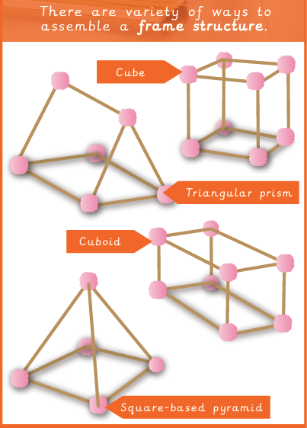
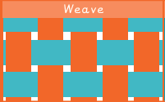
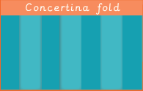
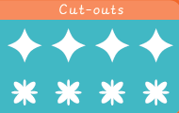
Key Vocabulary
3D shapes | Shapes that show their length, width and depth.
Cladding | A covering or coating on a structure or building.
Frame | A stable structure that supports a building.
Pavilion | A structure built for shelter.
Reinforce | Strengthen or add support.
Stable | Unlikely to give way or fall over.
Structure | A building or object made from several different parts.
Texture | The feel or consistency of an object.
Design Technology – Structures
Knowledge Organiser
Key Knowledge
1 | A free-standing structure is one that can stand on its own.
2 | Cubes, cuboids, triangular prisms and square-based pyramids are examples of frame shapes to create structures.
3 | A pavilion is a decorate building or structure.
4 | Cladding is a covering which can be applied to create different effects and textures.
5 | Weaves, concertinas and cut-outs are examples of cladding techniques.
6 | Reinforcing corners can make structures more strong and stable.
7 | Frames must be designed to support the weight of buildings.
Prior Knowledge
Year 1 | Mechanisms | Structures can be made stronger, stiffer and more stable.
Year 2 | Structures | Structures with wide, flat bases are the most stable.
Year 3 | Mechanical Systems | Making complex structure stiffer, stronger and more stable.

