Slide 1
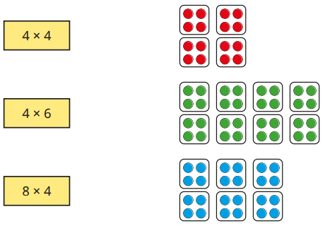


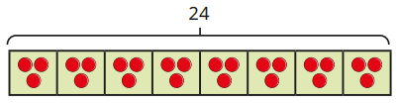
Multiplication and Division – Multiply and Divide by 3, 4 & 8 - Knowledge Organiser
Key Vocabulary
Multiplication | The process of adding the same number multiple times.
Division | Splitting a number into equal groups.
Equal groups | Groups of objects that have the same amount in each group.
Arrays | A way of organizing objects or pictures into columns and rows.
Repeated addition | Adding the same number multiple times.
Sharing | Dividing a quantity equally among a certain number of groups.
Grouping | Putting a certain quantity in groups.
Key Information
1 | Make links between repeated addition and multiplication to calculate multiples of 3, 4 and 8.
2 | When dividing by 3, you either share into 3 equal groups or by grouping in 3s.
3 | When dividing by 4, you either share into 4 equal groups or by grouping in 4s.
4 | When dividing by 8, you either share into 8 equal groups or by grouping in 8s.
5 | We can use concrete or pictorial resources to support with multiplication and division.
Worked Examples
Multiply by 4: Match the multiplications to the pictures. Divide by 4: A shop sells apples in bags of 4. Each bag of apples costs £2. Rosie buys 36 apples. How much does Rosie spend? 36÷4 = 9 9x£2 = £18 Multiply by 8: How many legs do 5 spiders have? There are 8 legs on each spider. 8+8+8+8+8 = 40 5x8 = 40 Divide by 8: 24 sweets are shared equally into 8 bags. Dani uses a bar model to show this. 24÷8=3
Prior Knowledge
2 | Multiplication and Division | Multiplication and division facts for the 2, 5 and 10 times tables.
2 | Multiplication and Division | Recognise, make and add equal groups.
Worked Examples
Multiply by 3: There are 5 equal groups with 3 in each group. There are 15 altogether. 3+3+3+3+3 = 15 5x3 = 15 Divide by 3: The bar model shows 18÷3=6

Slide 2
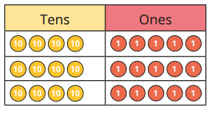
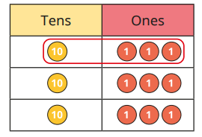
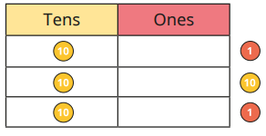
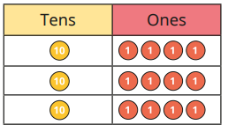
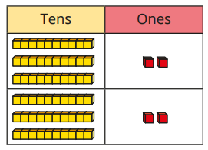
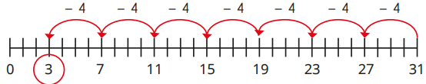
Multiplication and Division – Multiply and Divide 2-digit by 1-digit - Knowledge Organiser
Key Vocabulary
Multiplication | The process of adding the same number multiple times.
Division | Splitting a number into equal groups.
Partitioning | Separating larger numbers into smaller numbers like tens and ones.
Exchange | When you have to swap a ten for ten ones or ten ones for an additional ten.
Equal groups | Groups of objects that have the same amount in each group.
Remainders | When dividing, the amount left over that can’t be shared equally.
Key Information
1 | When multiplying, the 2-digit number should be partitioned into tens and ones and then multiplied by the 1-digit number.
2 | Once you have answers to the two parts, you then add these together to get the total.
3 | When dividing, the 2-digit number should be partitioned into tens and ones and then shared into equal groups.
4 | When dividing, you should share the tens first, followed by the ones.
5 | If the tens cannot be shared equally, each ten should be exchanged for 10 ones and then shared.
Worked Examples
Multiply 2-digit by 1-digit - exchange: Complete the number sentences. Use the place value chart for support. 5 ones x 3 = 15 ones 4 tens x 3 = 12 tens 120 + 15 = 135 45 x 3 = 135 Divide 2-digit by 1-digit – no exchange: Use the place value chart to work out 39÷3=13 Divide 2-digit by 1-digit – flexible partitioning: Rob uses counters to work out 42÷3. He cannot share the tens equally so exchanges one for ten ones and then shares the remaining ones. Divide 2-digit by 1-digit – remainders: Tommy uses repeated subtraction to work out 31÷4=7r3
Prior Knowledge
3 | Multiplication and division | Use their knowledge of already learnt multiplication and division facts.
Worked Examples
Multiply 2-digit by 1-digit – no exchange: Complete the number sentences. Use the place value chart for support. 2 ones x 2 = 4 ones 3 tens x 2 = 6 tens 60 + 4 = 64 32 x 2 = 64

