Slide 1
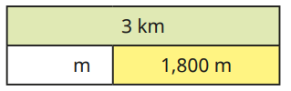
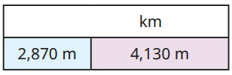
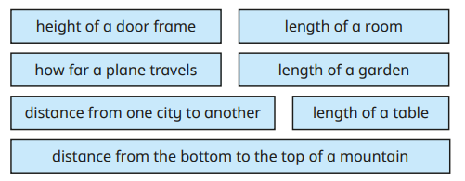
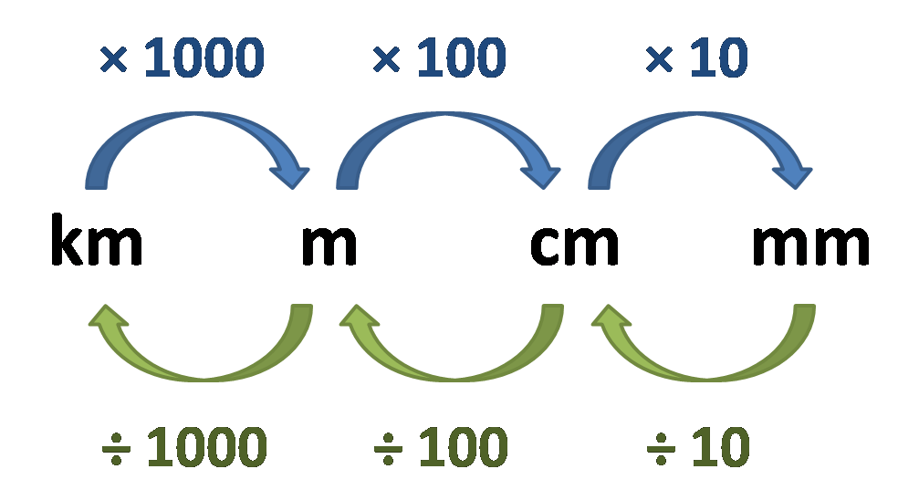
Length and Perimeter: Metres and Kilometres.
Key Vocabulary
Kilometre | A unit of measurement. Larger than a metre.
Length | How long something is.
Metre | A unit of measurement. Smaller than a kilometre.
Key Information
1 | There are 1000m in 1km.
2 | 1km = 1000m 2km = 2000m 10km = 10,000m 45000m = 45km 12000m = 12km 34000m = 34m
3 | Kilometres are used to measure longer lengths or distances.
Worked Examples
1,200
7
Worked Examples
Prior Knowledge
Year 2 | Length and height. | One centimetre is smaller than one metre.
Year 3 | Length and perimeter. | One millimetre is smaller than one centimetre. 1cm = 10mm 1m = 100cm
Year 4 | Multiplication and Division | Multiplying and dividing by 10 and 100.
Measured in metres | Measured in kilometres
Height of a door frame. Length of a room. Length of a garden. Length of a table. | How far a plane travels. Distance from one city to another. Distance from the bottom to the top of a mountain.

Slide 2
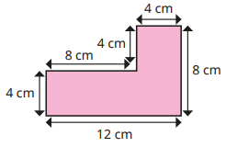
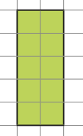
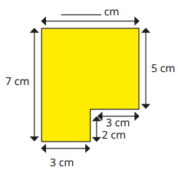
Length and Perimeter: Perimeter
Key Vocabulary
Length | How long something is.
Perimeter | The length of all sides of a shape, added together.
Two dimensional shape | A ‘flat’ shape which you can measure the length and width of.
Unit of measurement | What the length is measured ‘in’ e.g. cm, m, km.
Key Information
1 | Perimeter is the length of all sides of a shape added together.
2 | A square’s sides are all the same length.
3 | A rectangle has two pairs of equal sides.
4 | Some shapes have sides of all different lengths.
Worked Examples
4 + 8 + 4 + 4 + 8 + 12 = 40cm The perimeter is 40cm.
To find the missing side, add 3 and 3 together.
Worked Examples
Prior Knowledge
Year 3 | Length and perimeter | Adding and subtracting lengths.
Year 3 | Length and perimeter | What is perimeter?
Year 4 | Measurement | Calculating the space inside a shape: area.
1
2
14
3
The perimeter of this shape is 14cm.
6
13
4
12
5
6 + 5 + 3 + 2 + 3 + 7 = 26cm
The perimeter is26cm.
11
6
10
7
9
8

