Slide 1
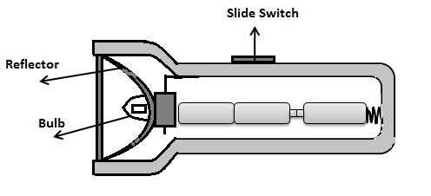
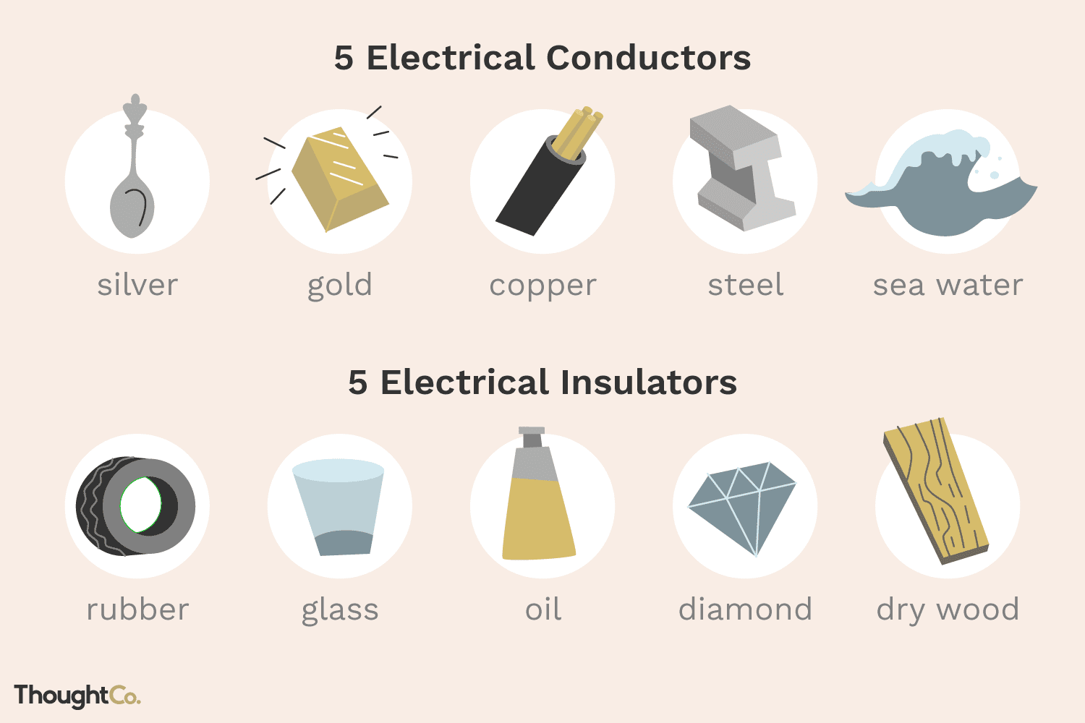
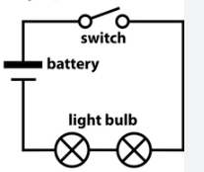
Key Vocabulary
Assemble | To put something together or to build it.
Battery | A cell which stores electricity.
Component | A part or an item of something bigger.
Conductor | A material which allows electricity to pass through.
Design criteria | A set of rules that must be followed in a design.
Electricity | A form of energy.
Evaluation | To reflect on a piece of work and identify the strengths and weaknesses.
Insulator | A material which does not allow electricity to pass through.
Series circuit | A circuit where the current follows one path.
Target audience | A particular group that a product is aimed at.
DT – Electrical Systems
Knowledge Organiser
Key Knowledge
1 | An electrical system is a group of components that work together to transport electricity.
2 | Torches use an electrical system (a circuit) in order to create light.
3 | Torch features include casing, bulbs, switches and reflectors.
4 | We can use design criteria to design and make a product for a particular person.
5 | We can make a torch using a plastic bottle, tin foil and a working circuit.
6 | Evaluation is important to identify what went well and what could have been better.
Prior Knowledge
Year 1 | Drawing | Different drawing tools can create different marks.
Year 1 | Drawing | Drawing tools could include pencils, pens, charcoal, pastels and felt tips.
Year 3 | Painting and Mixed Media | Different drawing tools can create different types of line.
Year 3 | Painting and Mixed Media | Light and dark colours next to each other create contrast.
Year 3 | Painting and Mixed Media | Shading can add texture to an artwork.
Key People
Benjamin Franklin – Known as the lightning tamer and researched positive and negative charges. Thomas Edison – Invented a form of light bulb.

