Slide 1
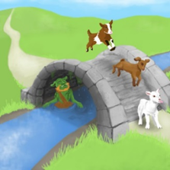
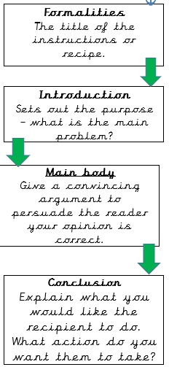
English – Persuasive Letter
Knowledge Organiser
Key Vocabulary
subordinating conjunction | A subordinating conjunction joins a subordinating clause to another clause or sentence
statement | .Common form of a sentence. It tells a fact.
command | Telling someone to do something
questions | Sentences that ask something
exclamations | A sentence that show surprise or express a feeling
Persuasive | The purpose is to convince the reader toward a certain point of view
Letter | Written message
Persuasive Structure
Worked Examples
Grammar Focus 1: To use subordinating conjunctions. I stayed inside because it was raining.
Grammar Focus 2: Identify and use statements, questions, exclamations and commands Question What time is it? Statement It is raining. Exclamation What a surprise! Command Sit down.
Key Information
1 | Persuasive letter is to convince someone of their point of view written in a letter
2 | Exclamations can start with ‘what’ or ‘how’ and end in an exclamation mark
3 | Commands usually start with an imperative verb known as a bossy verb. They tell someone to do something.
4 | Questions are sentences that ask something and end with a question mark
5 | Statements are sentences that state a fact
Prior Knowledge
 | Yr 1 | Use question marks to show where questions have been used.
 | Yr 1 | Use exclamation marks to show where an exclamation has been used.
 | Yr 1 | Join clauses using and, or, but.

