Slide 1
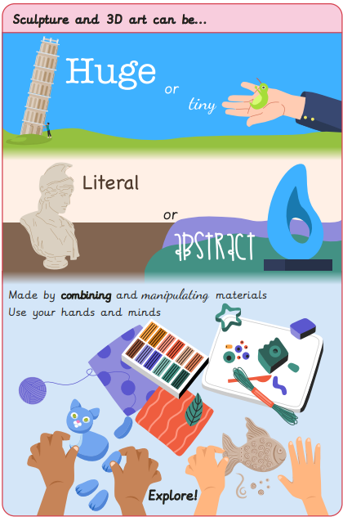
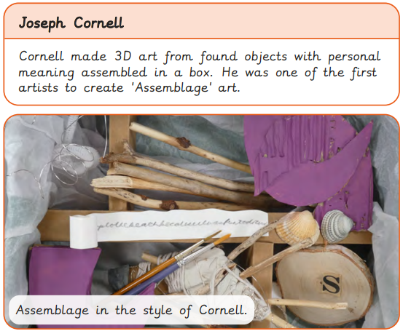
Key Vocabulary
Abstract | When something doesn’t necessarily look like it does in real life.
Assemblage | A 3-dimensional collage of collected or made items.
Composition | Putting different elements together in a pleasing way.
Literal | When something is represented exactly as it is.
Manipulate | To change how a material looks by handling or using.
Relief | In art, refers to artwork that projects from a solid base.
Sculpture | Three dimensional art made by carving, modelling, casting or constructing.
Art – Sculpture
Knowledge Organiser
Key Knowledge
1 | Materials can be manipulated to take art from 2D to 3D form.
2 | Artists use art to tell stories about things that are important to them; looking at artworks from the past can reveal thoughts and opinions from that time.
3 | Art can be a form of protest.
4 | Artists can use materials to respond to a feeling or idea in an abstract way.
5 | Artists can make work by collecting and combining ready-made objects to create ‘assemblage’.
Prior Knowledge
1 | Year 1 | 3D sculptures are ones that are off the page and have 3 dimensions to them
2 | Year 2 | Clay used to create sculptures can be joined together using the scratch and clip technique.
3 | Year 5 | 3D installations of art are types of sculpture.
4 | Year 5 | Space and scale are important when sculpting 3D art.
5 | Year 5 | Artists produce 3D art installations to express a point of view.
Key Artists
Louise Nevelson Joseph Cornell Judith Scott Yinka Shonibare Nicola Anthony Louise Bourgeois Romare Bearden

