Slide 1
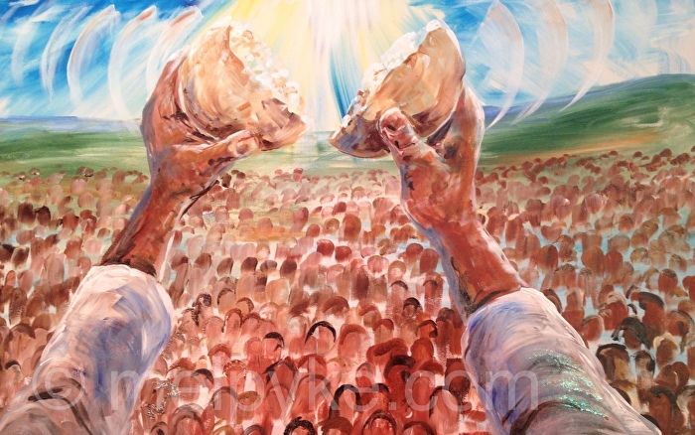
Sources
Key Information
1 | The Bible is inspired by the Holy Spirit and is the story of God’s love told by the people.
2 | The Bible tells of God’s love for his people and is used to shape the lives of Christians.
3 | There are different types of books in the Bible including scriptures, poems, psalms and Gospels.
4 | The books of the Bible are split into different genres.
5 | To find a book of the Bible, you look for the book, the big number is the chapter and smaller numbers the verses.
6 | We treat the Bible with care and reverence because it is the word of God.
Key Vocabulary
Bible | The Christian Holy Book.
Genre | A type of text
History | The stories of people from the past.
Information | Facts about the lives of people.
New Testament | The newer part of the Bible which contains information about the life of Jesus.
Old Testament | The Old Testament tells us the stories of the ancestors of Jesus and people who came before him.
Poetry | Psalms and poems are songs and prayers.
Stories | Information passed down by word of mouth and finally written down that tell us about the lives of religious people.
Are books enriching?
Prior Knowledge
1 | Special People | Our priest shares the words of the Bible during Mass.
2 | Books | The Bible is split into the Old and New testament and scripture and Gospels are taken from these.
3 | Journeys | Our journey through the liturgical year follows a Christian families journey with Jesus.
4 | Community | As Christians we are called to witness the word of God. We can affirm this in Confirmation.
5 | Mission | Religious people use the information from the Bible to share on their mission and spread the word of God.
Key Scripture Links
1 | Romans 15: 4-6

