Slide 1
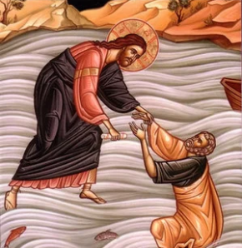
Key Vocabulary
Charity | An organization set up to provide help for those in need.
Donate | To give money or goods to a worthwhile cause.
Forgiveness | To stop feeling angry towards someone for something they have done.
Gathering | Coming together.
Giving | Providing something for someone else.
Hymn | A religious song of praise.
Introductory Rite | The first acts of worship in Mass.
Penitential Act | A part of the Introductory Rite, used to ask for and receive forgiveness.
Priest | An ordained minister, authorized to perform Mass.
Receiving | To be given or presented with something.
Serve | To perform duties or services for someone else.
Giving and Receiving Knowledge Organiser
Key Information
1 | Giving and receiving can be equally joyful.
2 | We are called by God to give to those in need and to be thankful for what we receive.
3 | The Introductory Rite is at the start of Mass and often includes a gathering hymn.
4 | The Penitential Act is part of the Introductory Rite and gives us the chance to ask for and receive forgiveness.
5 | It is good to have a balance of giving and receiving in order to make ourselves and others happy.
Is it better to give or receive?
Prior Knowledge
1 | Y2: Thanksgiving | Appropriate responses in Mass.
2 | Y3: Listening and Sharing | The order of Mass and specifically, the celebration of Holy Communion.
3 | Y4: Gift | We can give and receive material and non-material gifts.
4 | Y4: Community | The parish family celebrates Mass together.
Key Scripture Links
1 | Psalm 85:8a-8b
2 | Psalm 147:3
3 | Romans 8:34
4 | Ephesians 5:19

