Slide 1
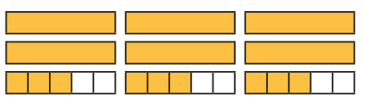
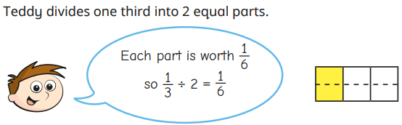
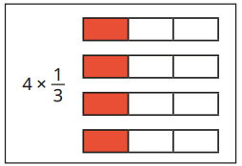
Fractions: Multiplying and Dividing Fractions Knowledge Organiser
Key Vocabulary
Compare | To look for similarities and differences.
Denominator | The bottom number of a fraction.
Fraction | A representation of a part of a whole.
Highest Common Factor | The highest factor two numbers have in common.
Integer | A number that is not a fraction, a whole number.
Lowest Common Multiple | The lowest multiples two numbers share.
Numerator | The top number in a fraction.
Order | First, second, third…..
Simplify | Reducing to a simpler form.
Key Information
1 | Improper fractions are where the numerator is bigger than the denominator.
2 | Mixed numbers are where fractions and integers are used together to represent one whole and a part whole.
3 | Multiplying fractions by an integer is have x amount of the fraction.
4 | Multiplying fractions by fractions means you multiply the numerators together and then the denominators together.
5 | When dividing fractions, you are sharing the fraction by the divisor. The numerator and denominator get larger.
Worked Examples
2 3/5 x 3 3 x 2 = 6 3/5 x 3 = 9/5 = 1 4/5 6 + 1 = 7 7 4/5 ½ x 1/3 = 1 x 1 = 1 2 x 3 = 6 Therefore ½ x 1/3 = 1/6
>
>
>
>
Prior Knowledge
Y1 | Recognise and name a half and quarter of a shape, object or quantity.
Y2 | Know the fractions 1/3 ¼ 2/4 ¾ and their equivalence.
Y3 | Unit fractions have 1 as the numerator and non unit fractions have a number greater than one as their numerator.
Y4 | Fractions with the same denominator can be added together by adding the numerators.
Y5 | Fractions can be compared and ordered depending on their denominator which gives their size value.
Worked Examples
4 4 4/12

