Slide 1
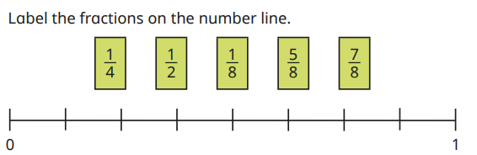
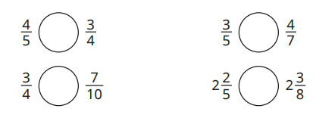
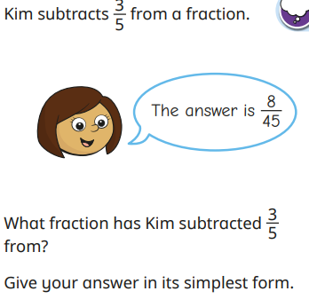
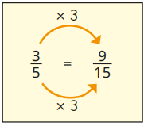
Fractions: Simplifying, adding and subtracting fractions Knowledge Organiser
Key Vocabulary
Compare | To look for similarities and differences.
Denominator | The bottom number of a fraction.
Fraction | A representation of a part of a whole.
Highest Common Factor | The highest factor two numbers have in common.
Integer | A number that is not a fraction, a whole number.
Lowest Common Multiple | The lowest multiples two numbers share.
Numerator | The top number in a fraction.
Order | First, second, third…..
Simplify | Reducing to a simpler form.
Key Information
1 | Common factors are used to simplify fractions using division. You need to find common factors of the numerator and the denominator.
2 | Simplified fractions are equivalent of each other. They share the same value.
3 | Improper fractions are where the numerator is bigger than the denominator.
4 | Mixed numbers are where fractions and integers are used together to represent one whole and a part whole.
5 | Denominators need to be the same when adding and subtracting fractions.
Worked Examples
Compare the following fractions: 1/3 + 1/12 = 4/12 + 1/12 = 5/12 1/3 + 7/12 = 4/12 + 7/12 = 11/12 2/3 – 5/9 = 6/9 – 5/9 = 1/9 7/9
>
>
>
>
Prior Knowledge
Y1 | Recognise and name a half and quarter of a shape, object or quantity.
Y2 | Know the fractions 1/3 ¼ 2/4 ¾ and their equivalence.
Y3 | Unit fractions have 1 as the numerator and non unit fractions have a number greater than one as their numerator.
Y4 | Fractions with the same denominator can be added together by adding the numerators.
Y5 | Fractions can be compared and ordered depending on their denominator which gives their size value.
Worked Examples

