Slide 1
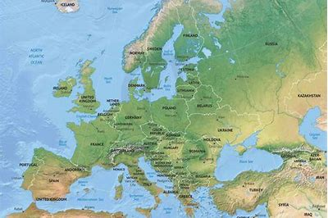
Europe Knowledge Organiser
Key Vocabulary
Compass Points | An instrument that shows direction (eg North, East, South, West)
Coordinates | A group of numbers used to indicate the position of a point, line or plane.
GMT | Greenwich Mean Time is the local mean time at Royal Observatory in Greenwich, London counted from midnight.
Grid References | A map reference indicating a location in terms of a series of vertical and horizontal grid lines.
Immigration | The action of coming to live permanently in a foreign country
Poverty | The state of being extremely poor.
Prime Meridian | Imaginary line from the North to the South Pole passing through Greenwich in London
Refugee | A person who has escaped from their own country for a political, religious or economic reason or because of war.
Residential | A place where people live with roads, facilities and work places.
Settlement | A place where people come to live.
Tourism | Business of providing services such as transport, places to stay or entertainment for people on holiday.
Key Information
1 | Europe is a one of the world continents and is made up of 44 countries. It is in the Northern hemisphere.
2 | A capital city is the place that functions as the seat of government and administrative centre of a country.
3 | Major capital cities such as London, Paris, Berlin, Rome, Amsterdam, Madrid, Stockholm are all capital cities in Europe.
4 | The Earth is split into horizontal lines of latitude and vertical lines of longitude
5 | The Prime Meriden is an imaginary line from the North to the South Pole that divides the Earth into 2 equal parts and runs through Greenwich, London.
6 | Greenwich Mean Time (GMT) is the yearly average of the time each day when the Sun crosses the Prime Meriden and we use this to set time.
7 | Europe is a wealthy continent and many people seek refugee here from other nations where they may be fleeing persecution.
8 | Many travel across the English channel to reach safety and face difficult journeys to be here.
9 | To cross the channel there is also an underground rail tunnel called the Channel Tunnel. This links the UK with the rest of Europe without having to sail or fly.
10 | There are laws protecting each country known as immigration laws that say who can and cannot enter your country to live.
Prior Knowledge
1 | Y1 Coastlines | The coastline is the land at the edge of an island. Britain is an island and you enter via the coastline from the sea.
2 | Y2 Sail the Seven Seas | The world is split into seven continent and each of these continents are divided into multiple countries.
3 | Y3 Greece | Greece is a country in Europe. Its capital city is Athens and this is where the government reside.
4 | Y4 Misty Mountain Sierra | There are aspects of physical geography such as mountains and rivers that can make travelling across Europe tricky.
5 | Y5 What makes Britain great | The United Kingdom is a country in the continent of Europe.

