Slide 1
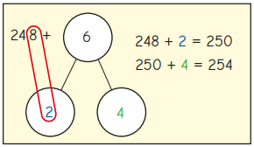
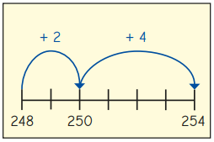
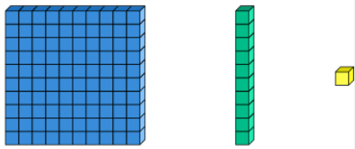
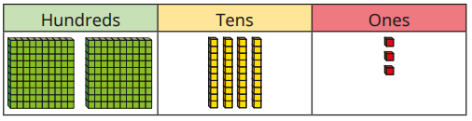
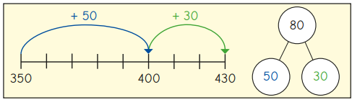


Addition and Subtraction – Add 1s, 10s and 100s - Knowledge Organiser
Key Vocabulary
Addition | Used to find the total of two or more values.
Hundreds | The digit worth hundreds - 100
Tens | The digit worth tens - 10
Ones | The digit worth ones - 1
Digit | Any numeral from 0 to 9.
Exchange | Used in addition when the total is over 9.
Base ten | 100 10 1
Place value counters
Column method | Digits are aligned correctly in order of their place value.
Key Information
1 | When 1s are added to a 3-digit number, the ones column changes every time.
2 | If there are more than 9 ones, you have to exchange 10 ones for an additional ten.
3 | When 10s are added to a 3-digit number, the tens column changes every time.
4 | If there are more than 9 tens, you have to exchange 10 tens for an additional hundred.
5 | When 100s are added to a 3-digit number, the hundreds column changes every time.
Worked Examples
You could use a part-whole model or a number to solve: 248 + 6 = 254 350 + 80 = 430
Prior Knowledge
2 | Addition and subtraction | Mentally add 1s and 10s to a 2-digit number.
2 | Addition and subtraction | Add 1 digit numbers to 2-digit numbers crossing 10.
Worked Examples
243 + 5 = 248 243 + 20 = 263

Slide 2
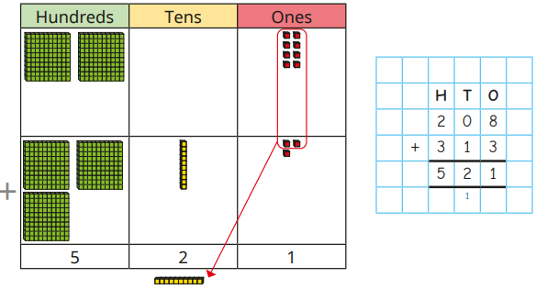
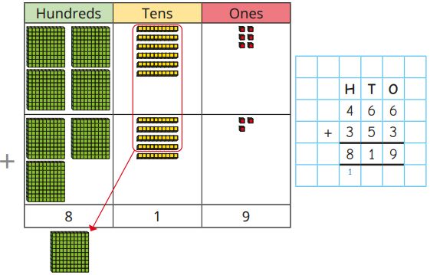
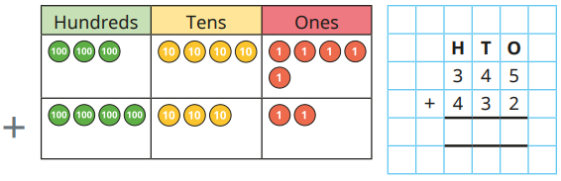

Addition and Subtraction – Add 2-digit and 3-digit - Knowledge Organiser
Key Vocabulary
Addition | Used to find the total of two or more values.
Hundreds | The digit worth hundreds - 100
Tens | The digit worth tens - 10
Ones | The digit worth ones - 1
Digit | Any numeral from 0 to 9.
Exchange | Used in addition when the total is over 9.
Base ten | 100 10 1
Place value counters
Column method | Digits are aligned correctly in order of their place value.
Key Information
1 | When adding two numbers, begin by adding the ones, then the tens, then the hundreds.
2 | Column method is a formal written method to add and subtract numbers.
3 | When adding, if there are more than 9 ones, you should exchange 10 ones for an additional ten.
4 | When adding, if there are more than 9 tens, you should exchange 10 tens for an additional hundred.
5 | When adding 2-digit to 3-digit, they should use zero as a place holder if there are no 100s
Worked Examples
Use base ten to work out 208+313 Use base ten to work out 466+353 Complete the bar model. 532 + 81 = 613
Prior Knowledge
2 | Addition and subtraction | Exchanging ten 1s for a ten.
3 | Addition and subtraction | Mentally added 1s, 10s and 100s with 3-digit numbers.
3 | Addition and subtraction. | Add 1s across 10 and 10s across 100.
Worked Examples
Find the sum of 345 and 432

Slide 3
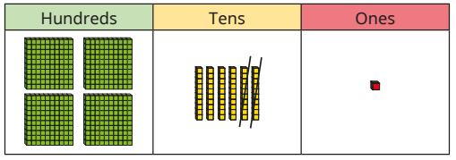
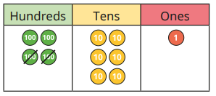
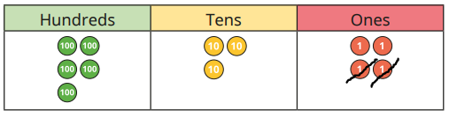
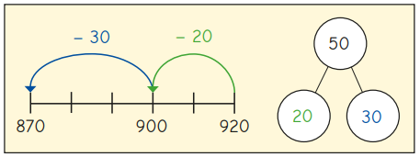

Addition and Subtraction – Subtract 1s, 10s and 100s - Knowledge Organiser
Key Vocabulary
Subtraction | Used to find the total of two or more values.
Hundreds | The digit worth hundreds - 100
Tens | The digit worth tens - 10
Ones | The digit worth ones - 1
Digit | Any numeral from 0 to 9.
Exchange | Exchange a 10 for 10 ones and a 100 for 10 tens.
Base ten | 100 10 1
Place value counters
Column method | Digits are aligned correctly in order of their place value.
Key Information
1 | When 1s are subtracted from a 3-digit number, the ones column changes every time.
2 | If there are not enough ones to subtract, you should exchange a ten for 10 ones.
3 | When 10s are subtracted from a 3-digit number, the tens column changes every time.
4 | If there are not enough tens to subtract, you should exchange a hundred for 10 tens.
5 | When 100s are subtracted from a 3-digit number, the hundreds column changes every time.
Worked Examples
Brett uses base ten and a place value chart to solve 461 – 20 = 441 Filip uses place value counters and a chart to solve 461 – 200 = 221 We can use a number line and a part whole model to solve 920 – 50 = 870
Prior Knowledge
2 | Addition and subtraction | Mentally subtract 1s and 10s from a 2-digit number.
2 | Addition and subtraction | Subtract 1 digit numbers from 2-digit numbers crossing 10.
Worked Examples
534 – 2 = 532 We can use a number line to work out 183 – 6 = 177

Slide 4
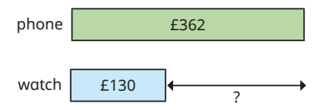
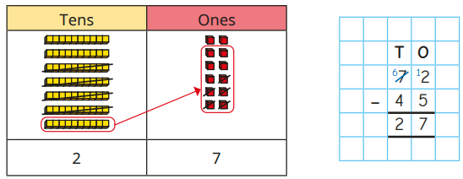
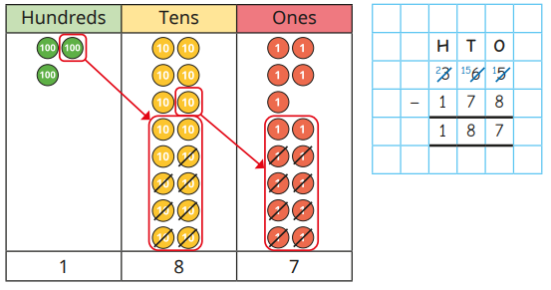
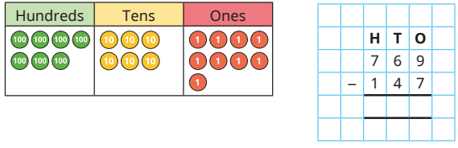
Addition and Subtraction – Subtract 2-digit and 3-digit - Knowledge Organiser
Key Vocabulary
Subtraction | Used to find the total of two or more values.
Hundreds | The digit worth hundreds - 100
Tens | The digit worth tens - 10
Ones | The digit worth ones - 1
Digit | Any numeral from 0 to 9.
Exchange | Exchange a 10 for 10 ones and a 100 for 10 tens.
Base ten | 100 10 1
Place value counters
Column method | Digits are aligned correctly in order of their place value.
Key Information
1 | When subtracting, subtract the smaller number away from the larger number.
2 | When subtracting, begin by subtracting the ones, then the tens, then the hundreds.
3 | Column method is a formal written method to add and subtract numbers.
4 | If you cannot subtract the bottom number from the top in the ones, exchange a ten for 10 ones.
5 | If you cannot subtract the bottom number from the top in the tens, exchange a hundred for 10 tens.
Worked Examples
A phone costs £362. A watch costs £130. How much more is the phone than the watch? £362 - £130 = £232 Use base ten and column subtraction to work out 72-45=27 Use place value counters and column subtraction to solve 365 – 178 = 187
Prior Knowledge
2 | Addition and subtraction | Exchange a ten for 10 ones.
3 | Addition and subtraction | Mentally subtract 1s, 10s and 100s from 3-digit numbers.
3 | Addition and subtraction. | Subtract 1s across a ten and 10s across a hundred.
Worked Examples
769-147 = 622

