Slide 1
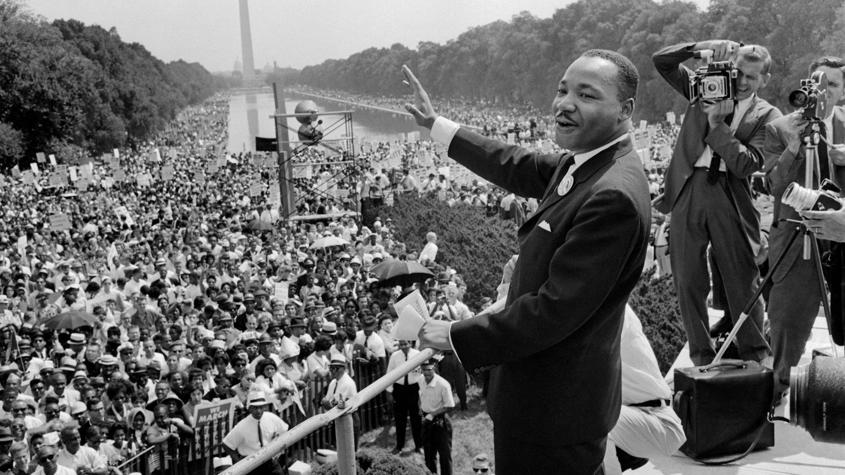
Road Trip USA Knowledge Organiser
Key Vocabulary
Chiefs | The leaders of Native American tribes.
Christopher Columbus | The man who is often credited with discovering the continent of North America.
Civil Rights Movement | A campaign which started in USA to end racial inequality and discrimination.
Culture | The traditions and way of life in a certain place.
Discrimination | The unfair treatment of groups of people.
Exploration | Exploring an unfamiliar location.
Influence | The ability to have an effect on someone or something else.
Longhouse | A long, rectangular house shared by Native Americans.
Native Americans | The earliest people to live in North America, before Europeans discovered it.
Population | The amount of people living in an area.
Racism | Treating someone unfairly because of their race or the colour of the skin.
Segregation | A form of discrimination where Black and White people were not allowed to mix.
Key Information
1 | Native Americans are the people who lived in North America before anyone else. Some of the tribes include the Navajo, the Sioux and the Cherokee.
2 | The Iroquois tribe settled in New York. They were ruled by chiefs and lived in longhouses. Many of them became Christians after the Europeans arrived.
3 | Christopher Columbus is given credit for discovering North America in 1492. It was actually Leif Erikson, a Viking, who found it first.
4 | Columbus accidentally discovered North America when he was headed for Asia. He was trying to find new spices and materials.
5 | Many American people have had a great impact on America, including Elvis Presley, Walt Disney and Barack Obama.
6 | The Civil Rights Movement began with the aim of ending inequality and racism against Black people.
7 | Martin Luther King Junior and Rosa Parks were two of the first leaders of the Civil Rights Movement.
8 | Racism is still a big problem across the world and it is illegal in the UK.
9 | Part of the inequality between Black and White people was segregation. Black people were not given the same rights as White people.
Prior Knowledge
1 | Year 1 – Land Ahoy | James Cooke discovered New Zealand and created maps.
2 | Year 1 – Land Ahoy | Pirates were explorers.
3 | Year 2 | Martin Luther King and Rosa Parks fought for equality.
4 | Y3 – Gods and Mortals | The Ancient Greeks made lots of significant contributions to the modern world.

