Slide 1
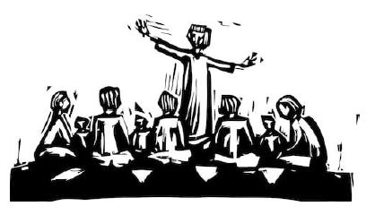
Key Vocabulary
Apostles | Each of the twelve disciples (special friends) of Jesus.
Catechist | Someone who teaches other people about the Word of God.
Commitment | Dedication to something important.
Community | A group of people sharing things in common.
Disciples | Anyone who is a follower of Jesus.
Greeter | Someone who welcomes others into a place.
Organist | Someone who plays an organ (a special instrument found in Churches).
Parish community | The group of people who take on roles in the church community.
Priest | An ordained man who can say the Mass.
Sacristan | Someone who helps the priest to get ready for Mass.
Serving | Helping each other and doing things for them.
Community Knowledge Organiser
Key Information
1 | We are all part of a range of communities: school, class, parish, sports etc.
2 | Jesus chose his twelve disciples to make God’s community bigger and to help him spread the Word.
3 | People in the parish community might have different rules including the priest, catechist, organist and flower arrangers.
4 | In God’s community, we are asked to ‘Be Real about Loving.’ This means trying our best to serve others.
5 | A community is created by the people in it.
What makes a community?
Prior Knowledge
1 | Year 1 – Special people. | There are lots of people in the parish family that take on special roles, such as the priest.
2 | Year 2 - Books | We hear the Word of God from the Bible when we celebrate Mass as a community.
3 | Year 3 - Journeys | The Christian family journey with Jesus, as a community, to grow closer to him.
Key Scripture Links
1 | Mark (3:12-19)
2 | Romans (12:8-11)
3 | Acts (6:2-13; 7:57-60)

